Slide 1
Up! Adventure is out there! Bulletin Board and Door Tag
Mary Beth Keiser & Nick Smith, 7th Floor RAs
Manhattan School of Music
Submitted by Wadner Auguste
Director of Residence Life
Manhattan School of Music

Slide 2
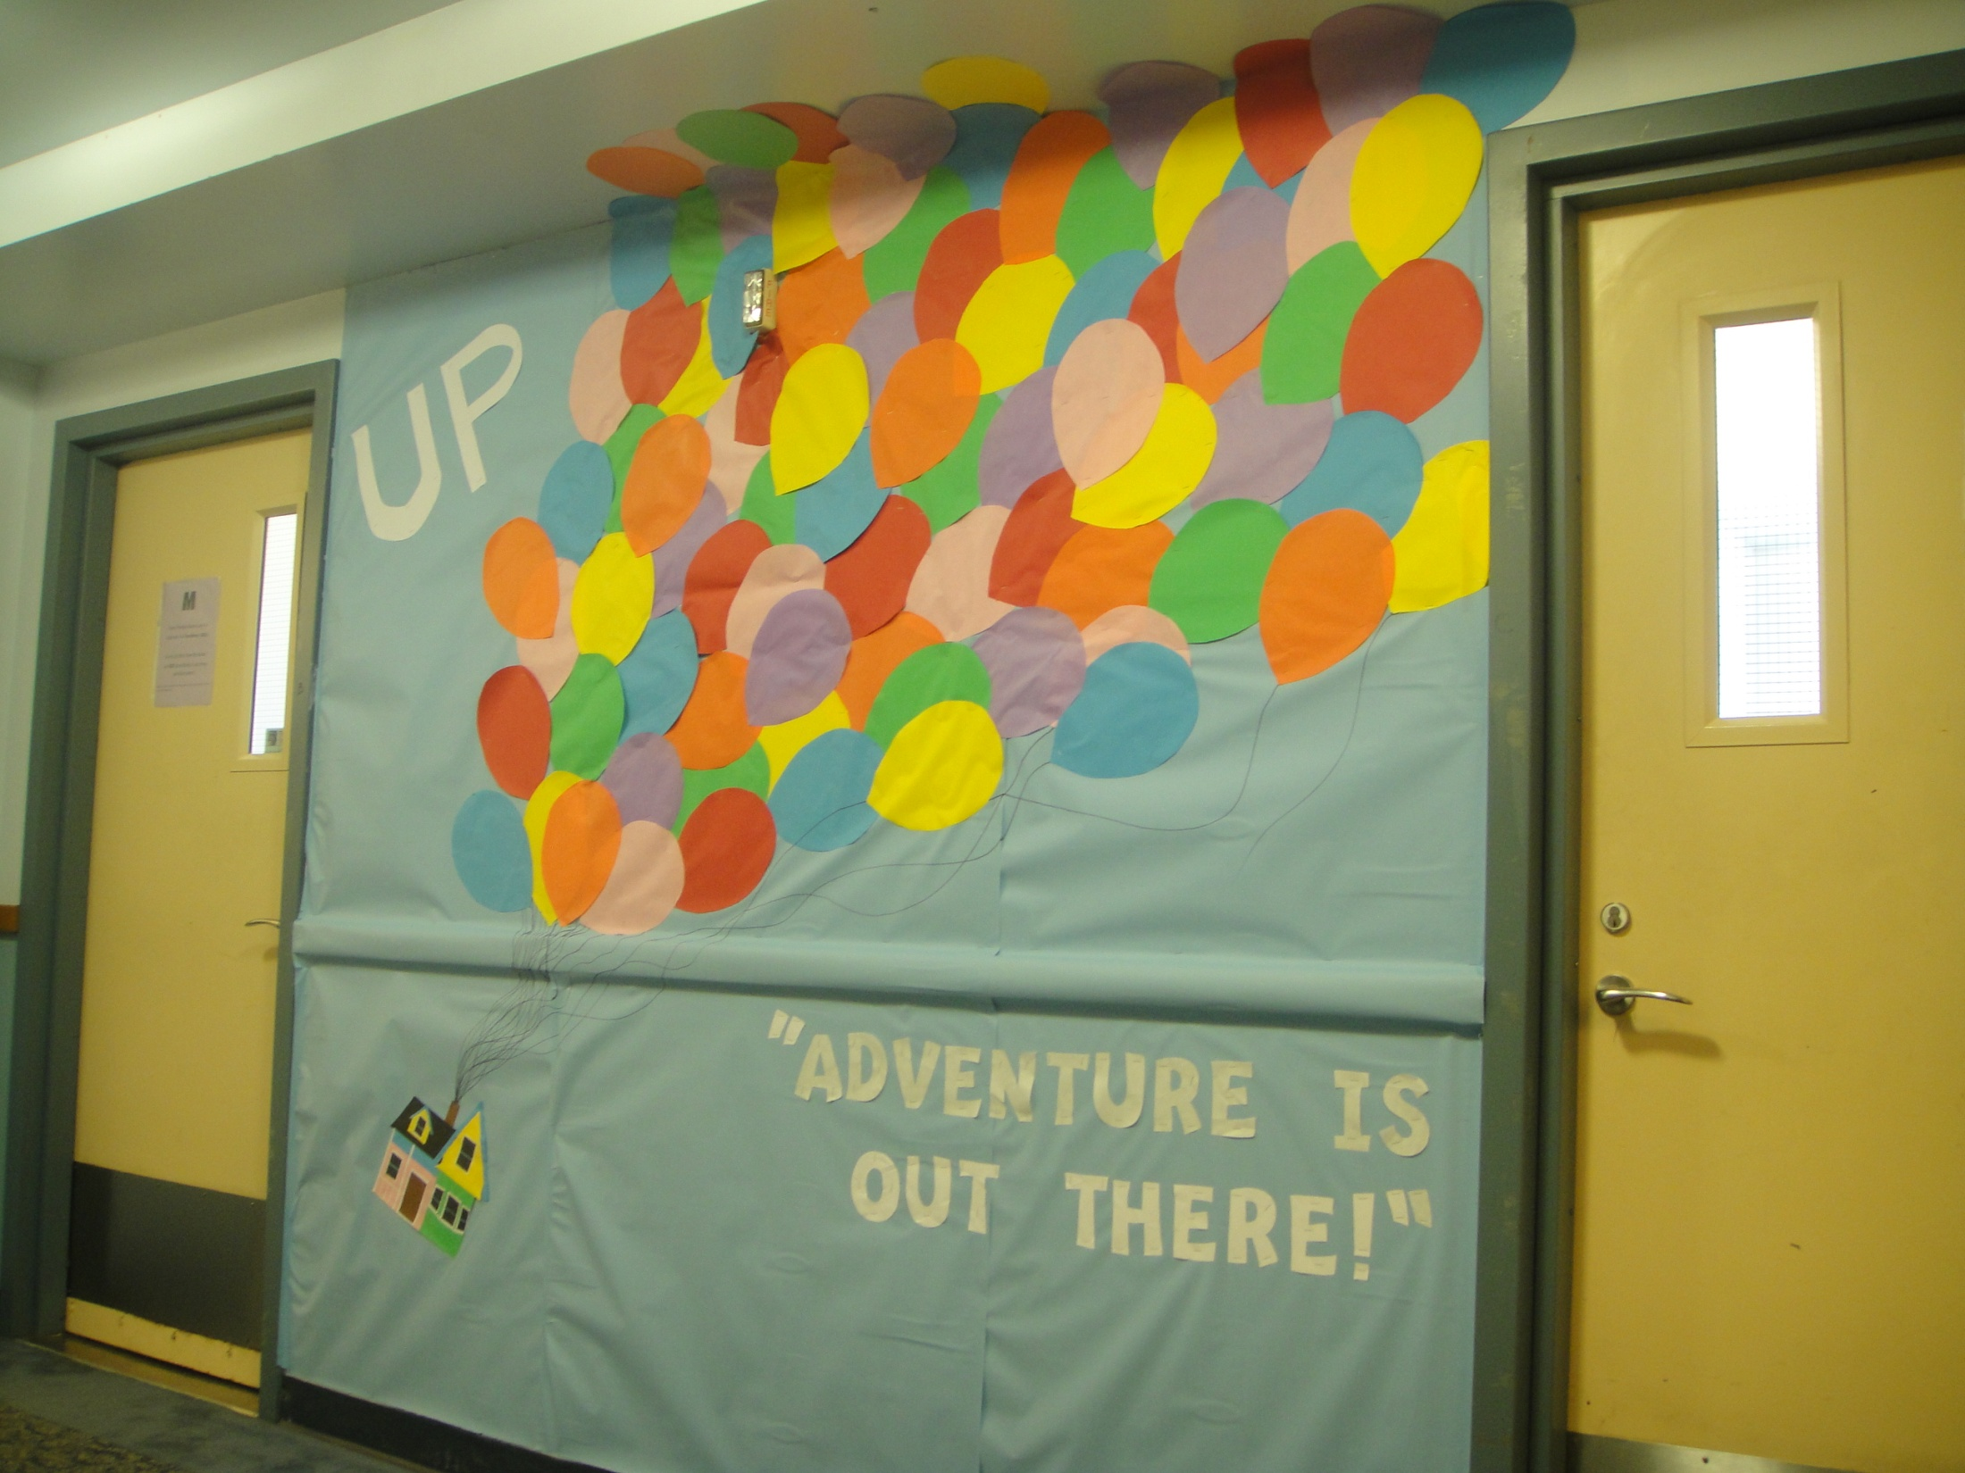

Slide 4
