Slide 1
Rock n’ Roll
Door Decorations
Submitted by Candey Aponte
Resident Assistant, Bixler Hall
Active Sister 079 and Vice President, Delta Epsilon Beta Sorority
University of New Haven

Slide 2
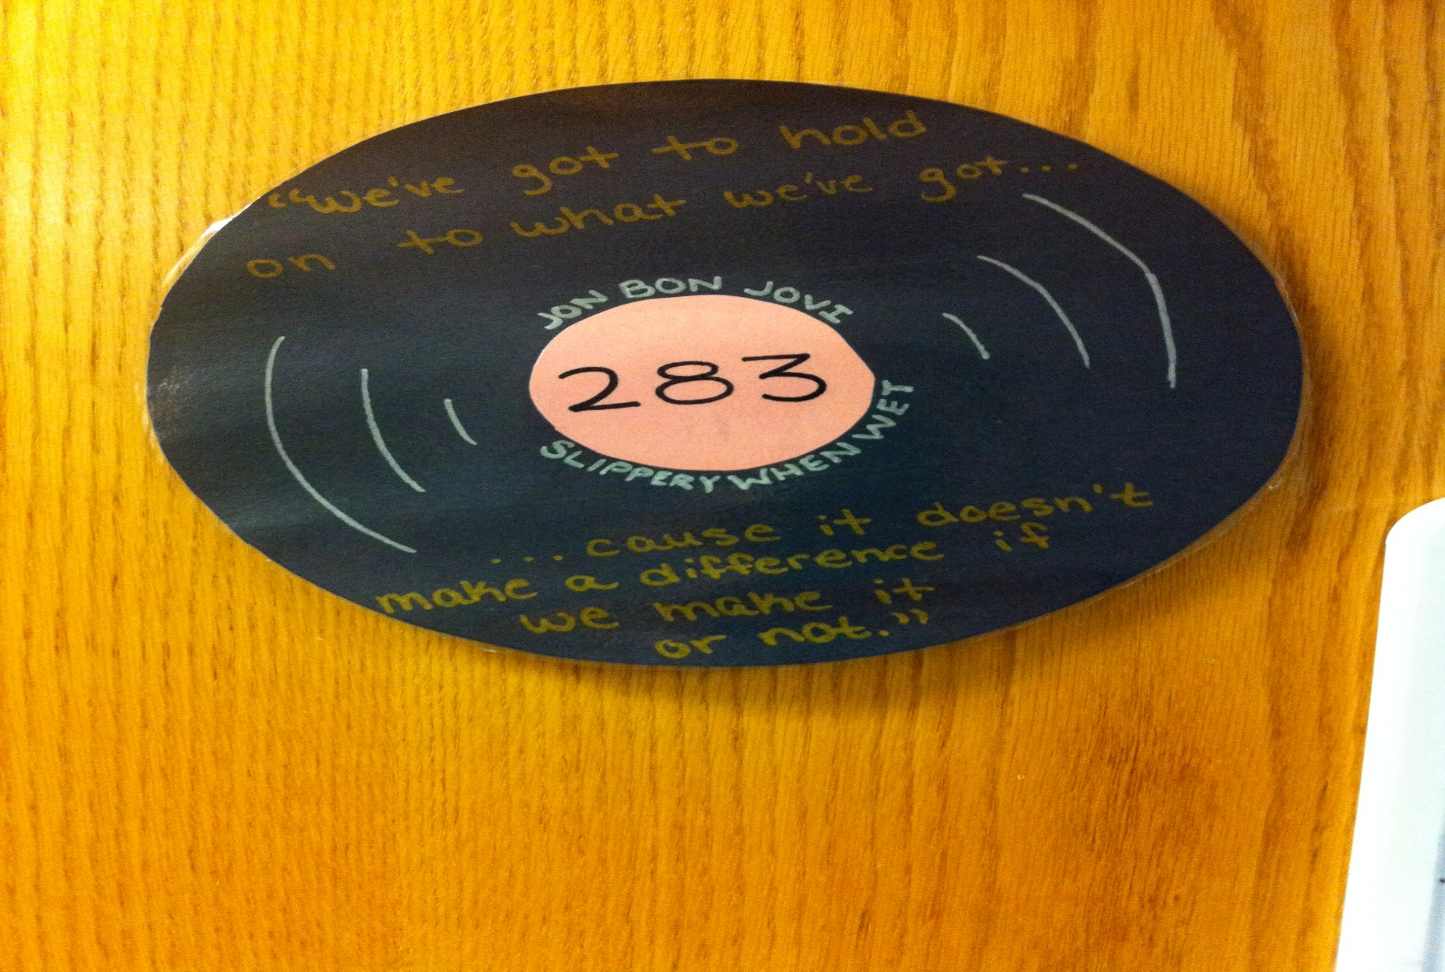
Vinyl Record Door Decoration Idea

Slide 3
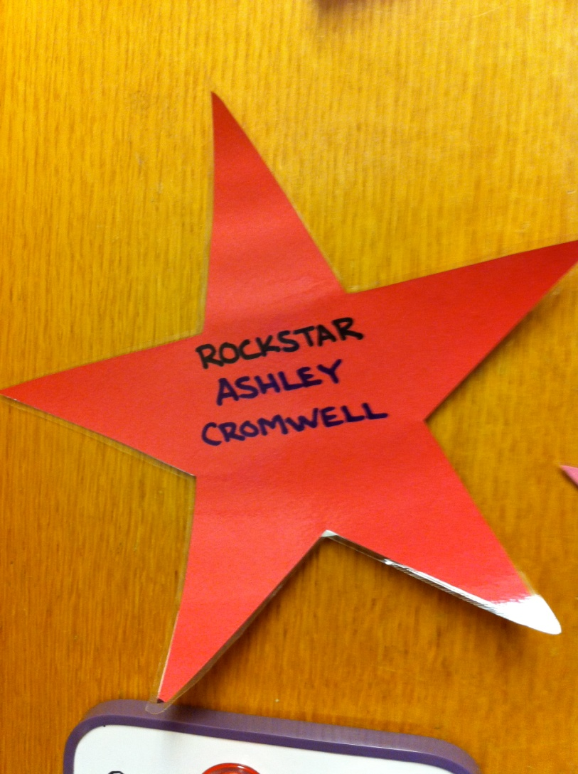
Rock Star Door Decoration

Slide 4
Making Rock n’ Roll Themed
Door Decorations
The theme in our residence hall was Rock n' Roll, so I made each resident a laminated construction paper star and each room a laminated vinyl record.
The star said "Rockstar ______________" with the individual residents' names filled in.
Each vinyl record was made out of black construction paper with different color inner circles. The example vinyl record uses black construction paper with a pink inner circle where I wrote the room number. I tried to make the vinyls as authentic as possible, with the name of the album and the artist written on the outside of the inner circle. Each vinyl also has an inspirational quote from that particular album.

