Slide 1
Hot Air Balloon--Origami
Ankur Goel
RA & Chemistry Lab Teaching Assistant
Virginia Commonwealth University

Slide 2
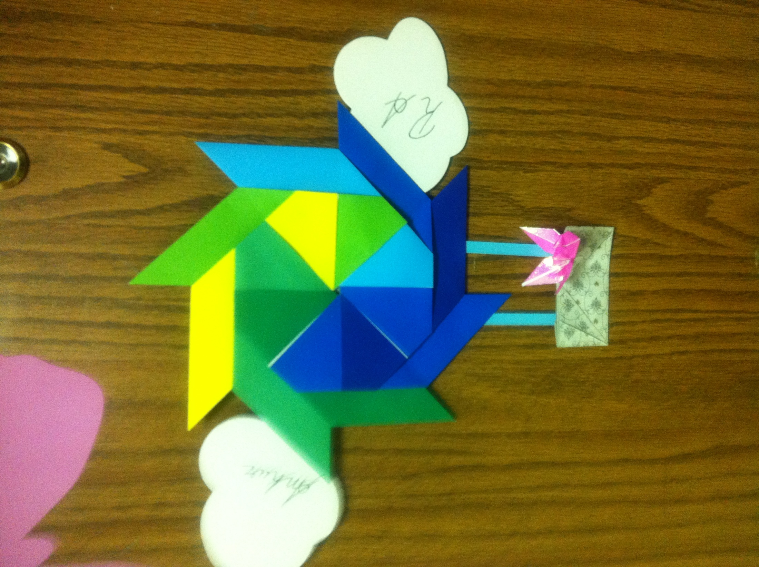

Slide 3
Note from Author
I made a windmill shape out of origami paper and a small rectangle as well.
Using some sort of thin paper or string (which will probably work the best), I taped the box to the hot air balloon.

