Slide 1
Meditate Away
Submitted by Kyle Brett
Resident Assistant
Lock Haven University

Slide 2
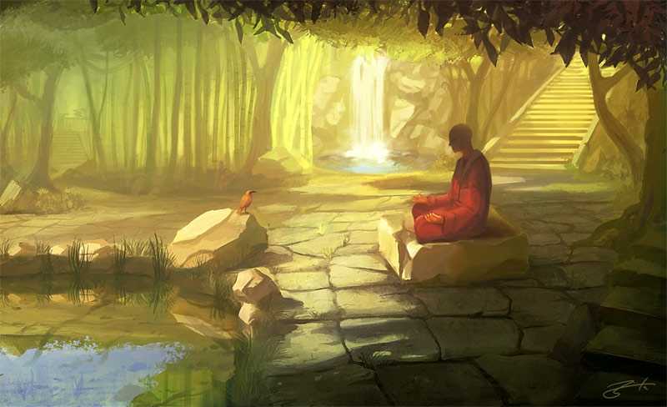
Meditate Away!
Brief explanation of a stress reduction technique used by Soto Zen Buddhists

Slide 3
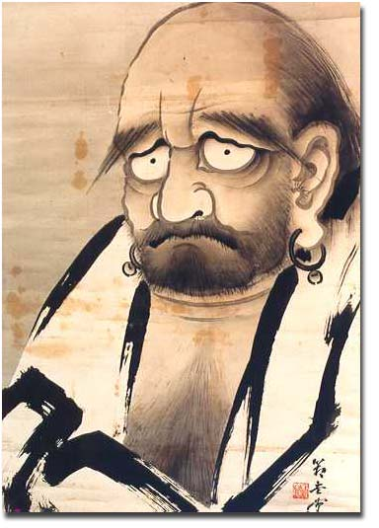
Zen History
Zen (Japanese) and Ch’an (Chinese) come from the Sanskrit word Dhyana. Dhyana means meditation.
It is no surprise, then, that Zen focuses on a practice of meditation to achieve enlightenment.
Zen Buddhism is a mix of Indian Buddhism and Taoism/Shinto cultural beliefs. Brought by Bodhidharma (right).
There are two main schools:
Rinzai
Soto

Slide 4
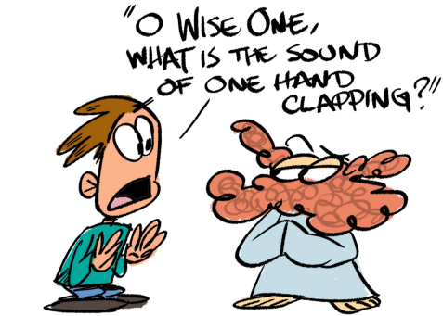
Soto and Rinzai
After coming to Japan from China, Zen broke into two schools.
Both schools focus on the practice of sitting or meditation as the core of their practices. Both schools hope to achieve a greater understanding of their lives (and thus the universe) by reaching enlightenment. They hope to do so in various ways.
Soto:
Focuses on just sitting without attachment to good or bad thoughts and concepts or mystical riddles. Known as “Farmer Zen.”
Rinzai:
Focuses on Koan (mystical riddle) as a subject of meditation. This riddle cannot be solved consciously and thus opens one up to “deeper understanding” Sometimes called “Samurai/Warrior Zen.”

Slide 5
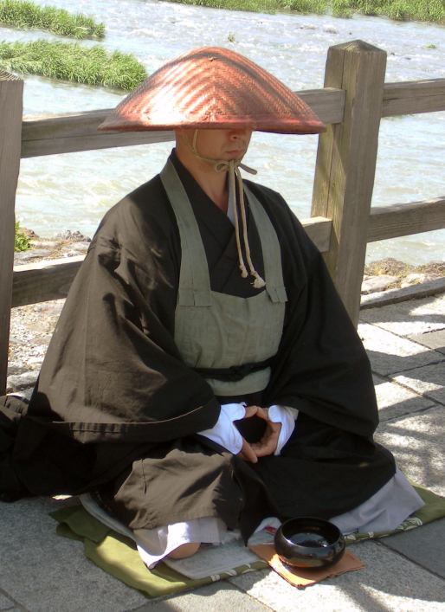
Why Sit?
Meditation has been proven to help you focus your attention and reduce daily stress and anxiety.
It is easy to learn, but hard to master (if possible at all).
You do not have to conform to a typical belief system (religion) to practice meditation.
Meditation can help with the following:
Allergies
Anxiety
Asthma
Depression
High blood pressure
Sleep problems

Slide 6
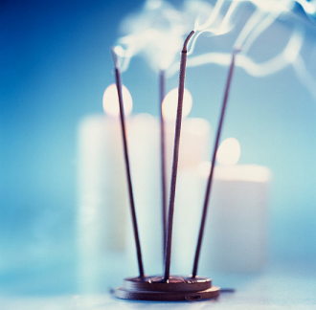
What you will need?
If you are interested in meditation you only need a few items. Luckily these items are more than likely in your rooms now.
Things you need:
Pillow/meditation seat
Timer (Use your phone’s built in alarm clock to help keep track)
A semi-quiet place (this includes outside)
Things that are nice to have
Altar (if you are apply the belief or just like the looks of a small altar).
Incense (only if you are not going to offend someone and if you are allowed to burn incense)
Special clothes (Robes are not needed but some prefer them)

Slide 7
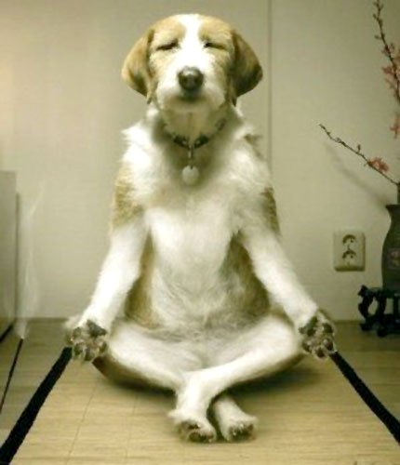
Now What?
So you have everything and are ready? But what do you do?
If you follow the Soto Zen style of meditation then:
Just sit or lay down.
Any position works. Crossed legged or laying down. If you are tired keep your eyes halfway open.
Follow, but do not attach to thoughts.
No really… that’s it.
You think I am kidding?
Okay, okay… you also have to breathe.

Slide 8
Tips and Tricks
Deceptively simple right? Here are some beginner tips:
Try the counting method.
Count to ten in your head with your breath (Inhale…one… Inhale… two… and so on). If you think of anything else other than the number start over. The object is not to get to ten but to learn how your mind works.
Think of your thoughts as clouds. No matter how much you hate storm clouds (bad or annoying thoughts) they will not leave by getting angry. They will pass if you just let them go without attaching to them.
Practice. Practice. Practice.
Start small. Start with ten minutes and lead into longer times.
Don’t be worried if you don’t feel anything the first time. There really is nothing to feel or obtain. Just a sense of calm of knowing you took ten minutes out of your day to enjoy your mind.

Slide 9
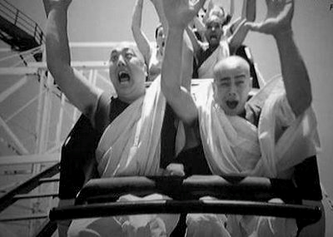
Frustrations?
If you are not getting what you think you should from meditation you should realize that this is a stress eliminating technique and not a modifier of stress.
Don’t get caught up in thinking you are never, ever, ever going to get enlightened or float or fart lotus blossoms. Just sit and meditate away. Besides… these guys devoted their lives to practice and still know how to have a good time. Good Luck!

Slide 10
Credits
Made by Kyle Brett from Lock Haven University
Sources:
www.mayoclinic.com
www.religionfacts.com
Images from: Google Images

