Slide 1
Twister Bulletin Board and Door Tags
Lock Haven University
Pennsylvania
Featured Institution
Submitted by Wendy Walsh, Student Life Coordinator

Slide 2
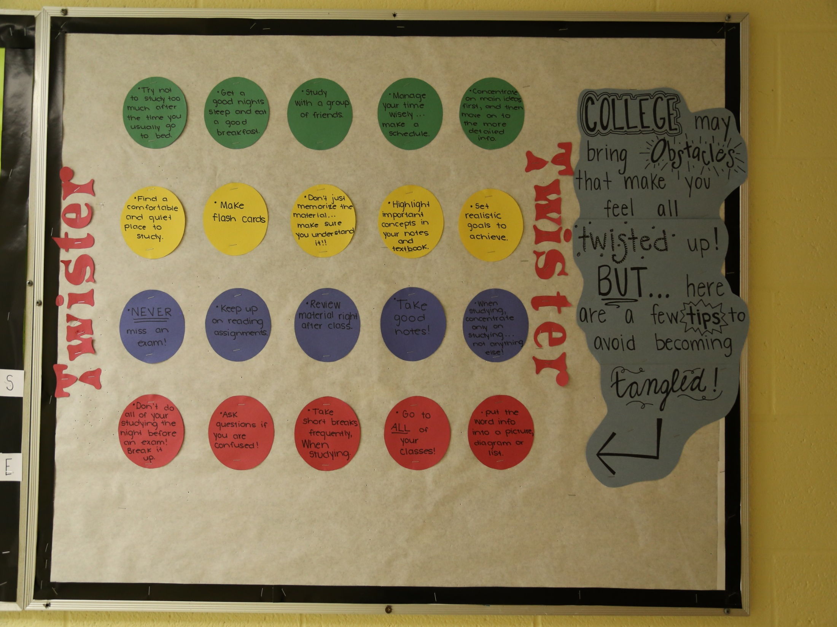

Slide 3
College has many obstacles that make you feel twisted up. Here are a few ideas to keep you from getting tangled!

Slide 4
Editors Note
The Twister idea could be expanded into door tags too!
The resident’s name could be placed on a circle made from construction paper (using the Twister colors: red, blue, green, and yellow!) and each roommate in the room, suite, or apartment could receive a different color.

