Slide 1
Storm Safety
Benjamin Throm
Resident Assistant
Northwest Missouri State University

Slide 2
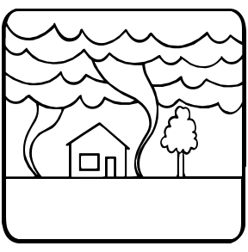

Slide 3
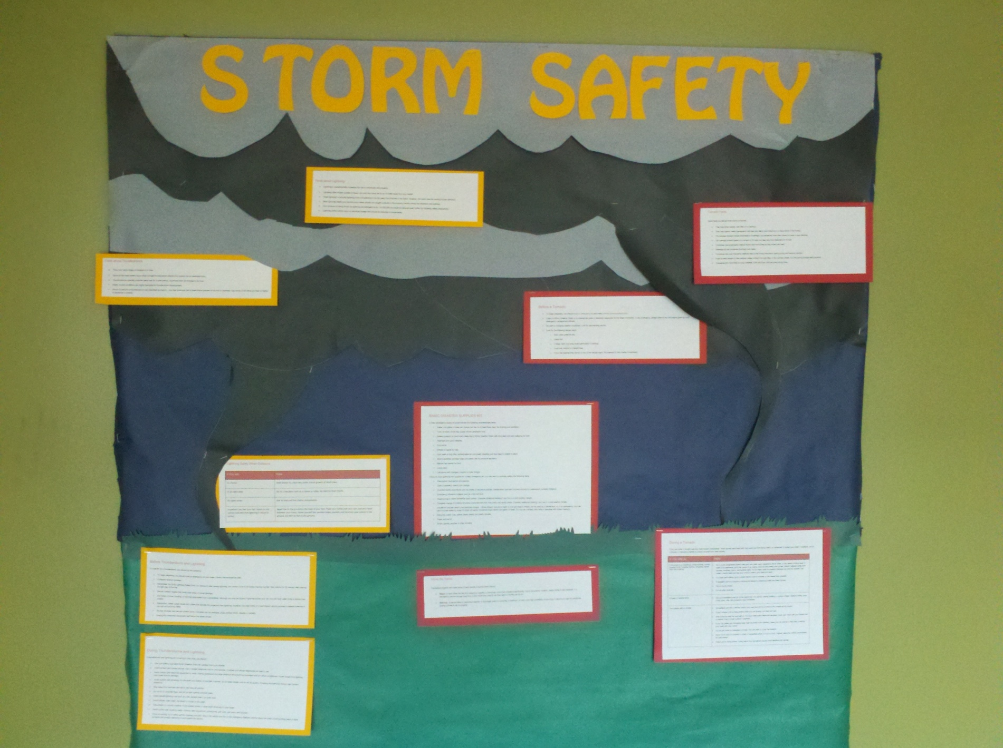

Slide 4
Before Thunderstorm and Lightning
To prepare for a thunderstorm, you should do the following:
To begin preparing, you should build an emergency kit and make a family communications plan.
Postpone outdoor activities.
Remember the 30/30 Lightning Safety Rule: Go indoors if, after seeing lightning, you cannot count to 30 before hearing thunder. Stay indoors for 30 minutes after hearing the last clap of thunder.
Secure outdoor objects that could blow away or cause damage.

Slide 5
Before Thunderstorm and Lightning
Get inside a home, building, or hard top automobile (not a convertible). Although you may be injured if lightning strikes your car, you are much safer inside a vehicle than outside.
Remember, rubber-soled shoes and rubber tires provide NO protection from lightning. However, the steel frame of a hard-topped vehicle provides increased protection if you are not touching metal.
Shutter windows and secure outside doors. If shutters are not available, close window blinds, shades or curtains.
Unplug any electronic equipment well before the storm arrives.

Slide 6
Facts about Thunderstorms
They may occur singly, in clusters or in lines.
Some of the most severe occur when a single thunderstorm affects one location for an extended time.
Thunderstorms typically produce heavy rain for a brief period, anywhere from 30 minutes to an hour.
Warm, humid conditions are highly favorable for thunderstorm development.
About 10 percent of thunderstorms are classified as severe – one that produces hail at least three-quarters of an inch in diameter, has winds of 58 miles per hour or higher or produces a tornado.

Slide 7
Facts about Lightning
Lightning’s unpredictability increases the risk to individuals and property.
Lightning often strikes outside of heavy rain and may occur as far as 10 miles away from any rainfall.
“Heat lightning” is actually lightning from a thunderstorm too far away from thunder to be heard. However, the storm may be moving in your direction.
Most lightning deaths and injuries occur when people are caught outdoors in the summer months during the afternoon and evening.
Your chances of being struck by lightning are estimated to be 1 in 600,000 but could be reduced even further by following safety precautions.
Lightning strike victims carry no electrical charge and should be attended to immediately.

Slide 8
Lightning Safety When Outdoors
IF YOU ARE: THEN:
In a forest Seek shelter in a low area under a thick growth of small
trees.
In an open area Go to a low place such as a ravine or valley. Be alert for flash floods.
On open water Get to land and find shelter immediately.
Anywhere you feel your hair
stand on end
(which indicates that lightning
is about to strike) Squat low to the ground on the balls of your feet. Place your hands over your ears and your head between your knees. Make yourself the smallest target possible and minimize your contact it the ground. DO NOT lie flat on the ground.

Slide 9
During Thunderstorms and Lightning
If thunderstorm and lightning are occurring in your area, you should:
Use your battery-operated NOAA Weather Radio for updates from local officials.
Avoid contact with corded phones. Use a corded telephone only for emergencies. Cordless and cellular telephones are safe to use.
Avoid contact with electrical equipment or cords. Unplug appliances and other electrical items such as computers and turn off air conditioners. Power surges from lightning can cause serious damage.
Avoid contact with plumbing. Do not wash your hands, do not take a shower, do not wash dishes, and do not do laundry. Plumbing and bathroom fixtures can conduct electricity.

Slide 10
During Thunderstorms and Lightning
Stay away from windows and doors, and stay off porches.
Do not lie on concrete floors and do not lean against concrete walls.
Avoid natural lightning rods such as a tall, isolated tree in an open area.
Avoid hilltops, open fields, the beach or a boat on the water.
Take shelter in a sturdy building. Avoid isolated sheds or other small structures in open areas.
Avoid contact with anything metal—tractors, farm equipment, motorcycles, golf carts, golf clubs, and bicycles.
If you are driving, try to safely exit the roadway and park. Stay in the vehicle and turn on the emergency flashers until the heavy rain ends. Avoid touching metal or other surfaces that conduct electricity in and outside the vehicle

Slide 11
Know the Terms
Familiarize yourself with these terms to help identify a thunderstorm hazard
Watch- is used when the risk of a hazardous weather or hydrologic event has increased significantly, but its occurrence, location, and/or timing is still uncertain. It is intended to provide enough lead time so that those who need to set their plans in motion can do so.
Warning - is issued when a hazardous weather or hydrologic event is occurring, is imminent, or has a very high probability of occurring. A warning is used for conditions posing a threat to life or property.

Slide 12
Before a Tornado
To begin preparing, you should build an emergency kit and make a family communications plan.
Listen to NOAA Weather Radio or to commercial radio or television newscasts for the latest information. In any emergency, always listen to the instructions given by local emergency management officials.
Be alert to changing weather conditions. Look for approaching storms.
Look for the following danger signs:
Dark, often greenish sky
Large hail
A large, dark, low-lying cloud (particularly if rotating)
Loud roar, similar to a freight train.
If you see approaching storms or any of the danger signs, be prepared to take shelter immediately.

Slide 13
Tornado facts I
Quick facts you should know about tornadoes:
They may strike quickly, with little or no warning.
They may appear nearly transparent until dust and debris are picked up or a cloud forms in the funnel.
The average tornado moves Southwest to Northeast, but tornadoes have been known to move in any direction.
The average forward speed of a tornado is 30 mph, but may vary from stationary to 70 mph.

Slide 14
Tornado facts II
Tornadoes can accompany tropical storms and hurricanes as they move onto land.
Waterspouts are tornadoes that form over water.
Tornadoes are most frequently reported east of the Rocky Mountains during spring and summer months.
Peak tornado season in the southern states is March through May; in the northern states, it is late spring through early summer.
Tornadoes are most likely to occur between 3 pm and 9 pm, but can occur at any time.

Slide 15
During a Tornado
If you are under a tornado warning, seek shelter immediately!
Most injuries associated with high winds are from flying debris, so remember to protect your head. If available, put on a bicycle or motorcycle helmet to protect yourself from head injuries.

Slide 16
If you are in a structure (e.g. residence, small building, school, nursing home, hospital, factory, shopping center, high-rise building)
Go to a pre-designated shelter area such as a safe room, basement, storm cellar, or the lowest building level. If there is no basement, go to the center of an interior room on the lowest level (closet, interior hallway) away from corners, windows, doors, and outside walls. Put as many walls as possible between you and the outside. Get under a sturdy table and use your arms to protect your head and neck.

Slide 17
If you are in a structure
In a high-rise building, go to a small interior room or hallway on the lowest floor possible.
If available, put on a bicycle or motorcycle helmet to protect yourself from head injuries.
Put on sturdy shoes.
Do not open windows.

Slide 18
If you are in a trailer or mobile home
Get out immediately and go to the lowest floor of a sturdy, nearby building or a storm shelter.
Mobile homes, even if tied down, offer little protection from tornadoes.

Slide 19
If you are in the outside with no shelter
Immediately get into a vehicle, buckle your seat belt and try to drive to the closest sturdy shelter.
If your vehicle is hit by flying debris while you are driving, pull over and park.
Stay in the car with the seat belt on. Put your head down below the windows; cover your head with your hands and a blanket, coat or other cushion if possible.

Slide 20
If you are in the outside with no shelter
If you can safely get noticeably lower than the level of the roadway, leave your car and lie in that area, covering your head with your hands
Do not get under an overpass or bridge. You are safer in a low, flat location.
Never try to outrun a tornado in urban or congested areas in a car or truck. Instead, leave the vehicle immediately for safe shelter.
Watch out for flying debris. Flying debris from tornadoes causes most fatalities and injuries.

Slide 21
Basic Disasters Supplies Kit
A basic emergency supply kit could include the following recommended items:
Water, one gallon of water per person per day for at least three days, for drinking and sanitation
Food, at least a three-day supply of non-perishable food
Battery-powered or hand crank radio and a NOAA Weather Radio with tone alert and extra batteries for both
Flashlight and extra batteries
First aid kit

Slide 22
Basic Disasters Supplies Kit continued
A basic emergency supply kit could include the following recommended items:
Whistle to signal for help
Dust mask to help filter contaminated air and plastic sheeting and duct tape to shelter-in-place
Moist towelettes, garbage bags and plastic ties for personal sanitation
Manual can opener for food
Local maps
Cell phone with chargers, inverter or solar charger

Slide 23
Once you have gathered the supplies for a basic emergency kit, you may want to consider adding the following items:
Prescription medications and glasses
Cash or traveler's checks and change
Important family documents such as copies of insurance policies, identification and bank account records in a waterproof, portable container.
Emergency reference material such as a first aid book
Sleeping bag or warm blanket for each person. Consider additional bedding if you live in a cold-weather climate.
Complete change of clothing including a long sleeved shirt, long pants and sturdy shoes. Consider additional clothing if you live in a cold-weather climate.

Slide 24
Once you have gathered the supplies for a basic emergency kit, you may want to consider adding the following items:
Household chlorine bleach and medicine dropper – When diluted, nine parts water to one part bleach, bleach can be used as a disinfectant. Or in an emergency, you can use it to treat water by using 16 drops of regular household liquid bleach per gallon of water. Do not use scented bleach
Mess kits, paper cups, plates, paper towels and plastic utensils
Paper and pencil
Books, games, puzzles or other activities

Slide 25
Note from author
Hey all
For March and in light of the recent storms I have used information form ready.gov to create this bulletin board it has a lot of great tips. I have included the background, all the information and the finished product. Oh and I am Licensed Skywarn Storm Spotter for the National Weather Service. So I love storms and want to keep my residents safe and informed of the storm.
Benjamin Throm
Resident Assistant
466 Perrin Hall
Northwest Missouri State University

