Slide 1
Its Harvest Time in Tennessee A creative bulletin board idea
Candace Lawton, RA
University of Tennessee Knoxville

Slide 2
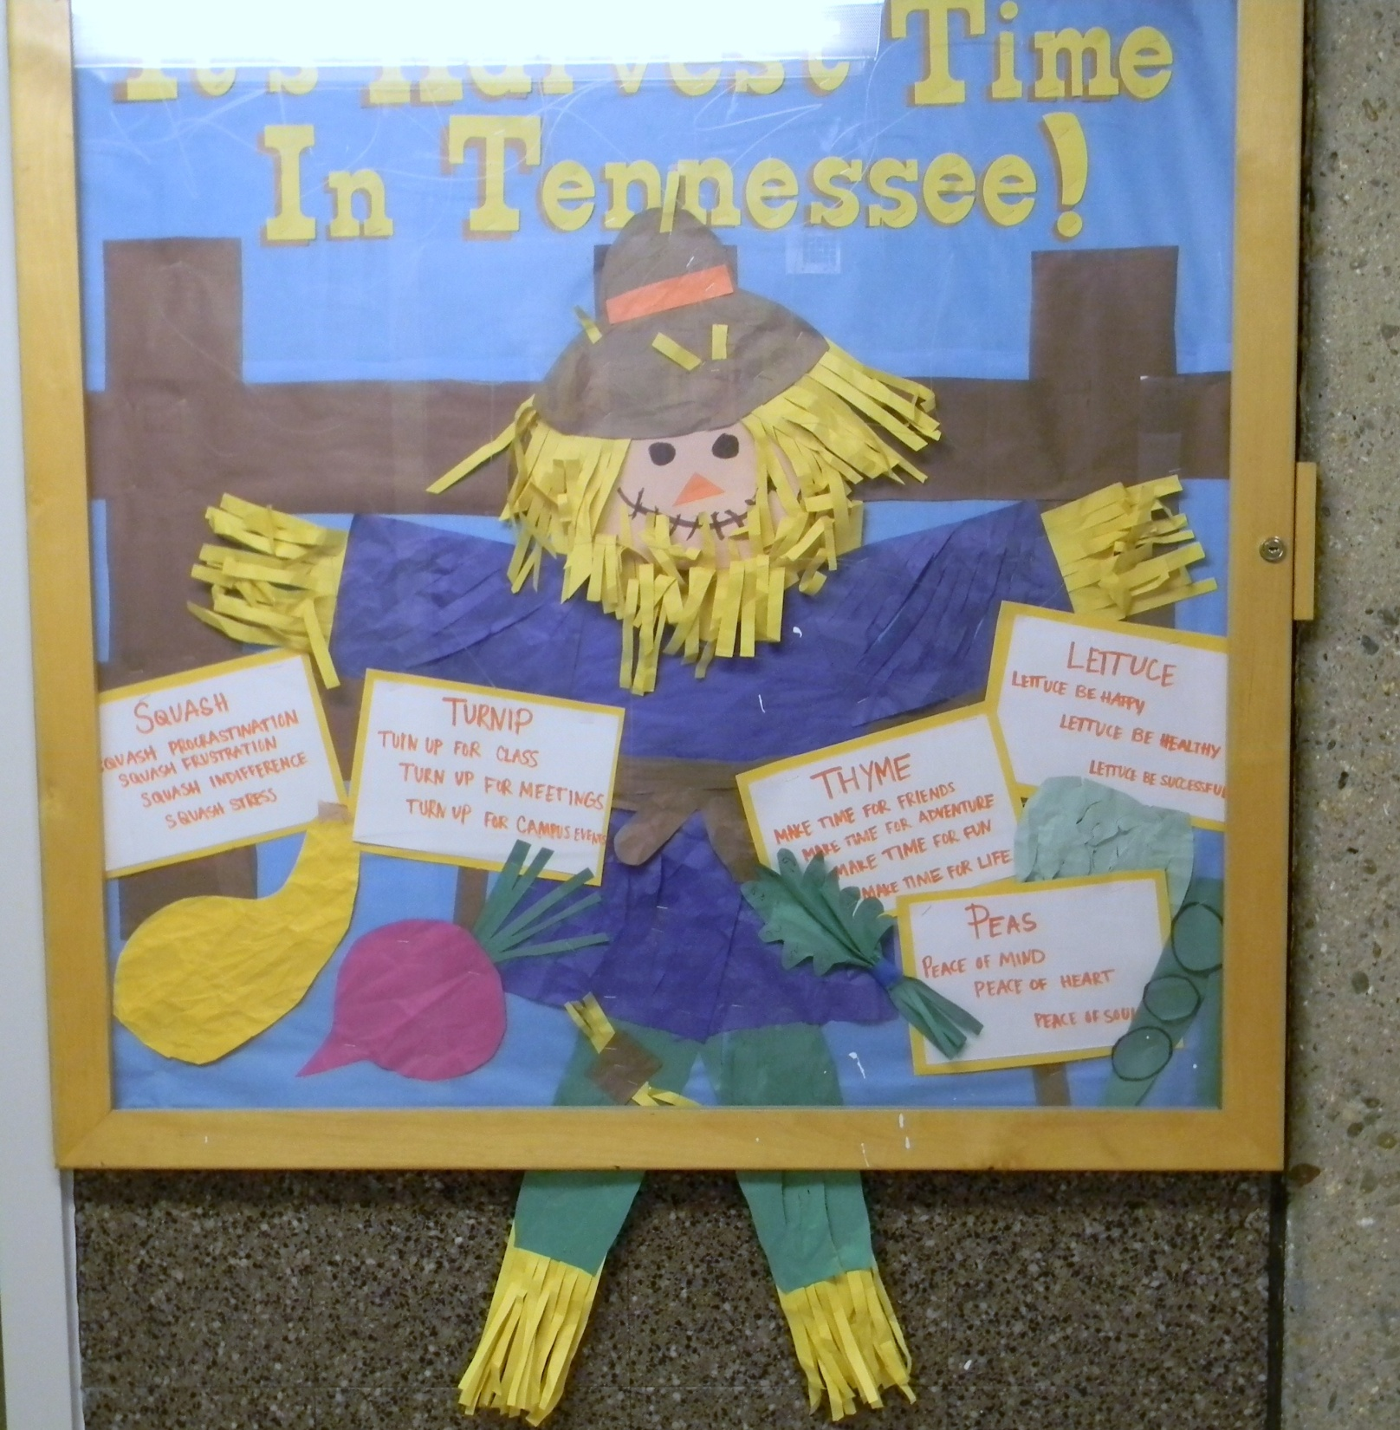

Slide 3
Its Harvest Time in Tennessee Bulletin Board Idea
The title is “It’s harvest time in Tennessee”
Feel free to adapt the title and the board to your institution!
Feel free to make parts of it 3-d and to go beyond the boundaries of the board

