Slide 1
Evolution
Ben Spoerlein Resident Assistant Ball State University Muncie, IN

Slide 2
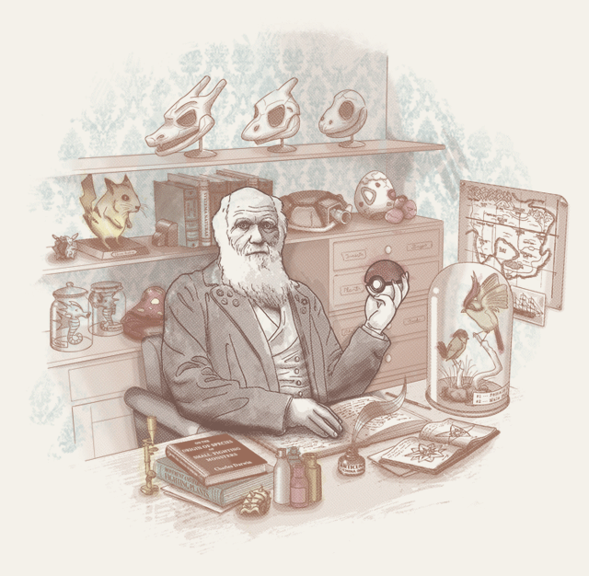

Slide 3
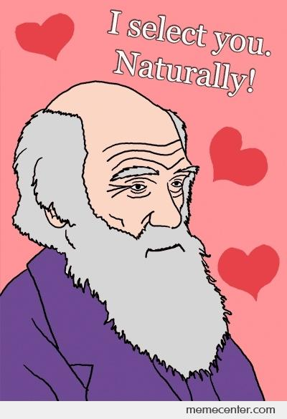

Slide 4
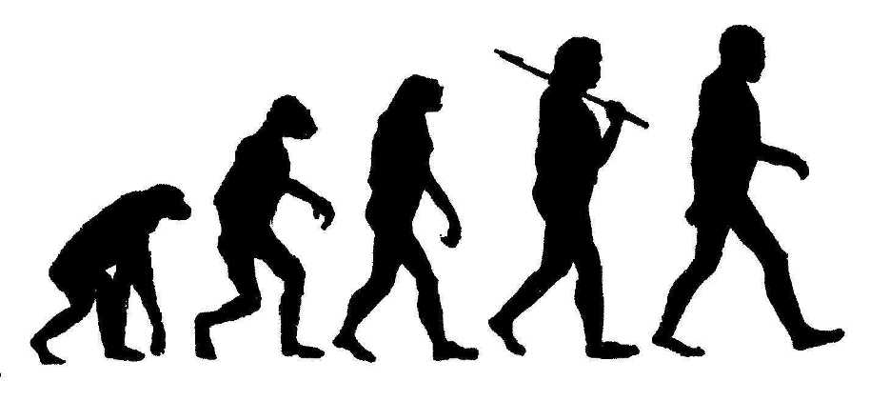

Slide 5
Charles Darwin (February 12th, 1809 – April 19th, 1882)
Credited with providing the first convincing evidence for the theory of evolution in his immortal work, On the Origin of Species, in 1859.
In 1831, Darwin set out on a science expedition aboard the H.M.S. Beagle.
On the trip, Darwin observed and collected specimens from South America and the Galapagos Islands. He noticed many variations among plants and animals.

Slide 7
On the Origin of Species
The full title of Darwin’s work is On the Origin of Species by Means of Natural Selection, or the Preservation of Favored Races in the Struggle for Life.
Darwin may have delayed publishing his work for fear of upsetting his clergymen naturalist friends or his pious wife Emma
After his journey on the Beagle, Darwin came to realize the fundamental principles of evolution:
Evolutionary change is gradual, requiring millions of years
The primary mechanism for evolution is natural selection
The millions of species alive today originate from a single original life form

Slide 8
“It is not the strongest of the species that survives, nor the most intelligent that survives. It is the one that is the most adaptable to change.”
- Charles Darwin

Slide 9
4 Ways Organisms Evolve

Slide 10
Natural Selection
Natural selection quite simply means that the organisms that survive and reproduce are the sole ancestors to the next generation of living things.
Those that die or fail to reproduce will not pass on their genes.
Hence, the harsh natural world selects which organisms survive.
If an organism’s adaptations allow them to survive more successfully in the world, then they pass on their genes to their offspring, and the cycle repeats.

Slide 11
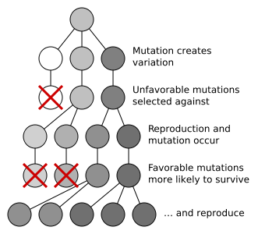

Slide 12
Genetic Drift
Random fluctuations in the frequency of the appearance of a gene in a small isolated population.
Chance has a role in determining whether a given individual survives and reproduces.
Genetic drift may cause gene variants to disappear completely, and thereby reduce genetic variation.

Slide 13
Mutation
Mutations are changes in the DNA sequence of a cell’s genome.
They are sudden and spontaneous changes in the cell
Mutations can be caused by radiation, viruses, mutagenic chemicals, as well as errors caused during meiosis or DNA replication
Mutations can have no effect at all, alter the product of a gene, or prevent the gene from functioning properly or completely.
Odds are if a gene mutates, you will not become a member of the X-Men.

Slide 14
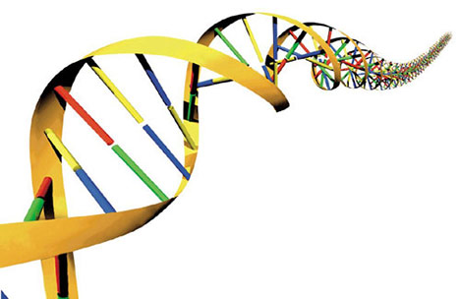
Gene Flow
Gene flow, or gene migration, is the transfer of genes from one population to another.
Gene flow can also occur between different species (hybridization).
This process of gene migration can be an important source of genetic variation.

Slide 15
Evidence for Evolution

Slide 16
Isn’t Evolution Only A Theory?
No! This stems from a misconception of the different definitions of the word “theory.”
Evolution is a scientific theory, which is an explanation or model based on observation, experimentation, and reasoning, especially one that has been tested and confirmed as a general principle helping to explain and predict natural phenomena.
This scientific definition of a theory is confused with an alternate definition in which a theory is an untested idea or opinion (a hypothesis).
Scientifically speaking, the theory of evolution is as valid as the theory of gravitation.

Slide 17
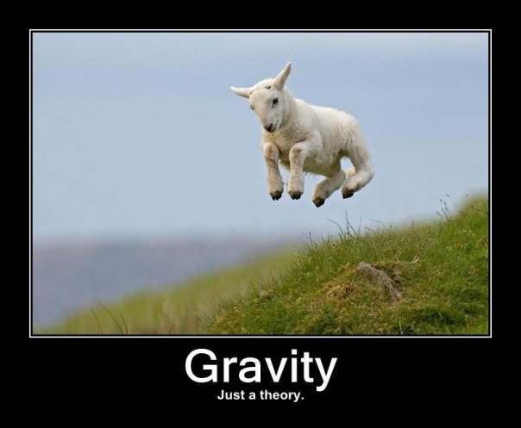

Slide 18
Genetic Evidence
More closely-related species have a greater fraction of identical DNA sequences when compared to more distantly-related species.
E.g. Humans have more DNA sequences in common with chimpanzees than they have in common with say, fish or amphibians.
All living species share the same basic mechanism of heredity using DNA (or RNA in some viruses).

Slide 19
Evidence from Comparative Anatomy
The similar anatomies of both fossilized and living creatures provide evidence for gradual change over time.
Even unrelated species have evolved similar forms to adapt to their respective environments.
E.g. Bats and Birds’ wings
Embryos of drastically different mammals are nearly identical to one another.
Even a human embryo passes through a stage in which it has gill structures like those of the fish from which all terrestrial animals evolve.

Slide 20
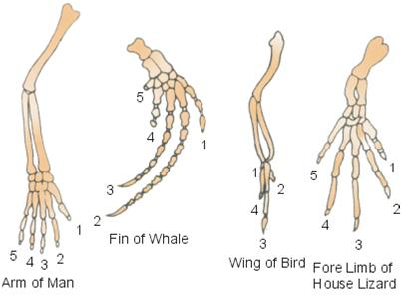

Slide 21
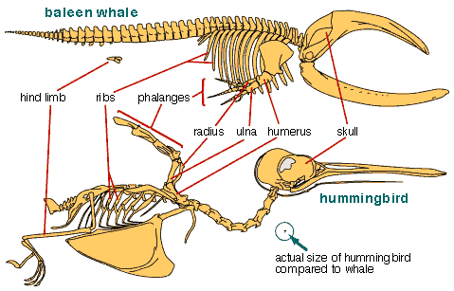

Slide 22
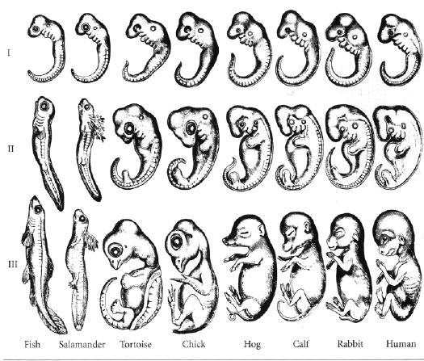

Slide 23
Fossil Evidence
It is possible to find out how a particular group of organisms evolved by arranging its fossil records in a chronological sequence.
This sequence can be determined by analyzing which stratum of sedimentary rock a fossil was discovered. (The lowest strata contain older rock and hence older fossils, while higher strata are comprised of newer rock and newer fossils)
Older fossil-bearing rocks contain fewer types of fossilized organisms, and they all have a simpler structure, whereas younger rocks contain a greater variety of fossils, often with increasingly complex structures.
Evolution could be easily contradicted if say, fossilized rabbit bones were discovered to be dated to the Precambrian Era.

Slide 24
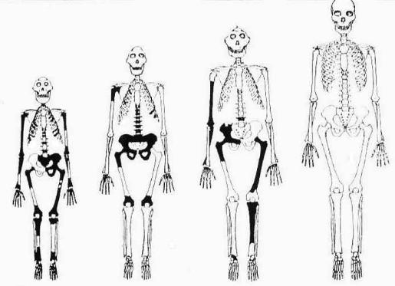

Slide 25
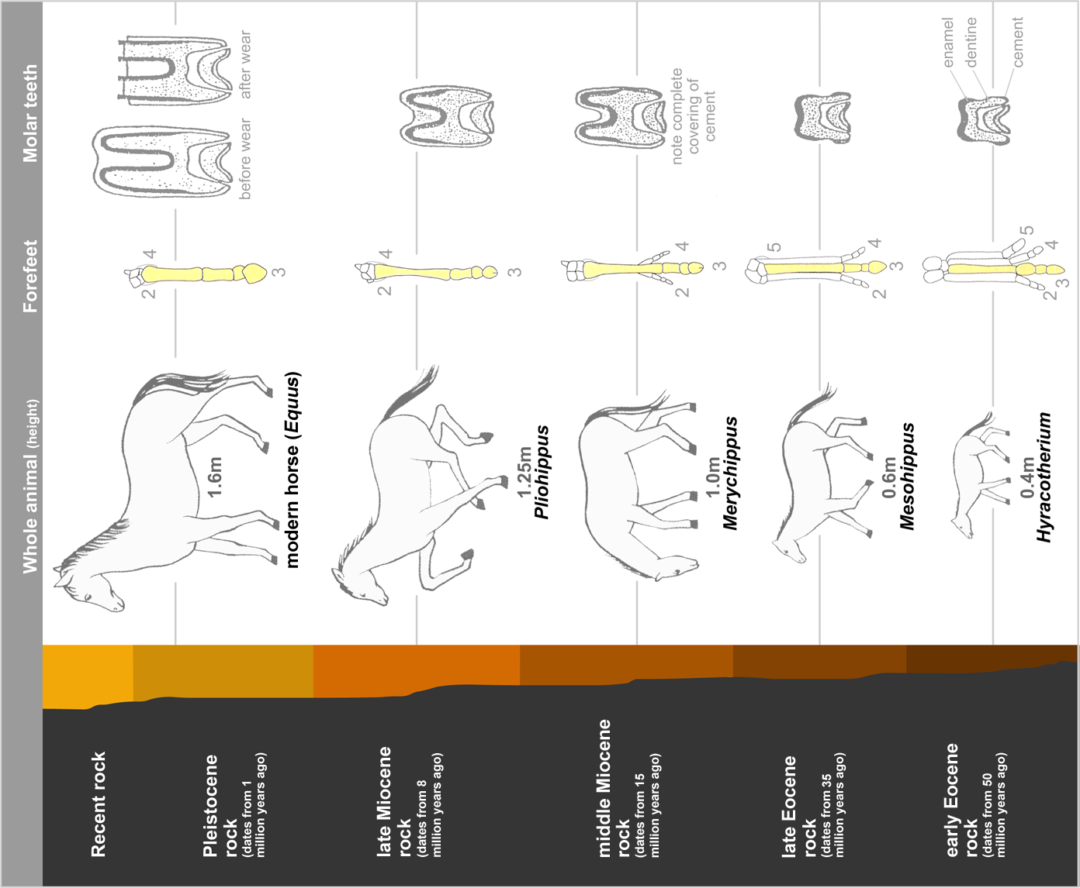

Slide 26
Evidence from Geographical Distribution
The presence or absence of species on various continents and islands can provide evidence of common descent.
Marsupials, like kangaroos, comprise half of Australia’s native mammal population; however, marsupials are totally absent from Africa, which has a similar climate.
North and South America have native cacti, but the deserts in Africa, Asia, and Australia have native euphorbs that resemble cacti but are not closely related.

Slide 27
Evidence from Artificial Selection
With artificial selection, one species is bred selectively at each generation, allowing only those organisms that exhibit desired characteristics to reproduce.
The desired characteristics become increasingly well-developed in successive generations.
Artificial selection demonstrates the diversity that can exist among organisms that share a relatively recent common ancestor.
A common example of artificial selection in action is man’s best friend: dogs!

Slide 28
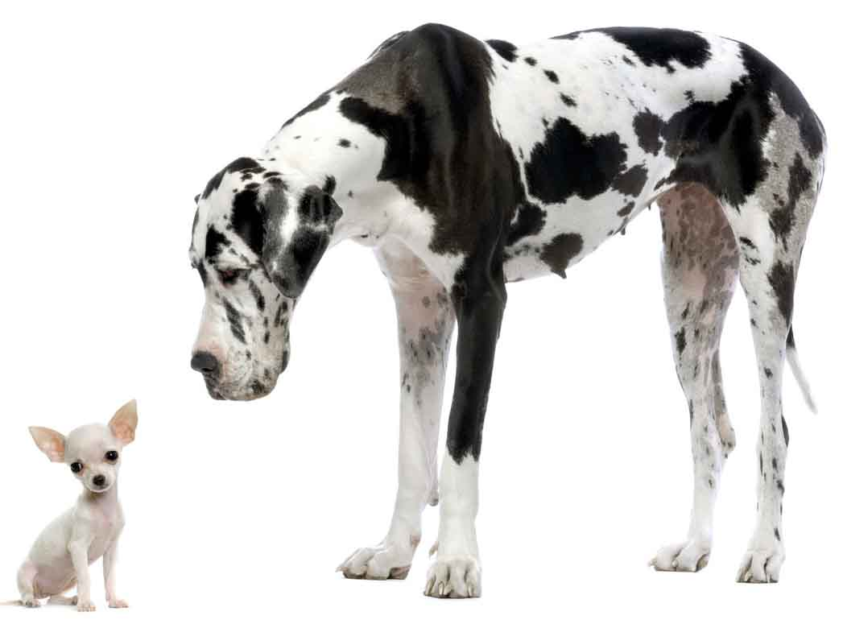

Slide 29
“For the first half of geological time our ancestors were bacteria. Most creatures still are bacteria, and each one of our trillions of cells is a colony of bacteria.” - Richard Dawkins

Slide 31
4.65 4.0 3.5 3.0 2.5 2.0 1.5 1.0 0.5
One of the reasons the theory of evolution is sometimes difficult to grasp is because our own lives are incredibly ephemeral. Individually, we can only live for about one century (and that’s if we’re lucky). The human brain has an especially difficult time trying grasp the billions of years that proceeded its own existence.
Take a look at the timeline of life on Earth below!

Slide 32
TIME (billions of years ago from the present)
Earth forms
Oldest rocks
Oldest bacteria fossils
Sulfate-reducing bacteria
Single-celled Eukaryotes
Multi-cellular Eukaryotes

Slide 33
Fish
Land Plants
Early Reptiles
Modern Mammals
Oxygen Levels Increase
Moon Forms
Flowers Emerge

Slide 34
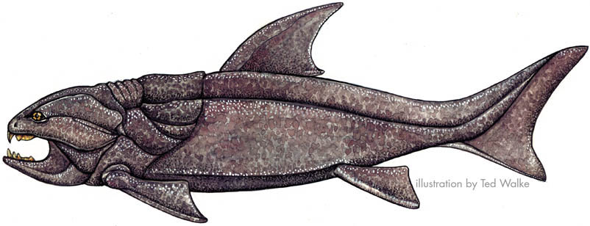
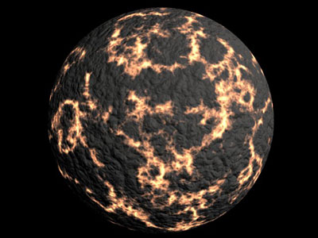

Slide 35
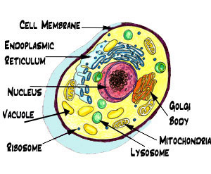
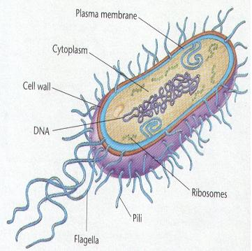

Slide 36
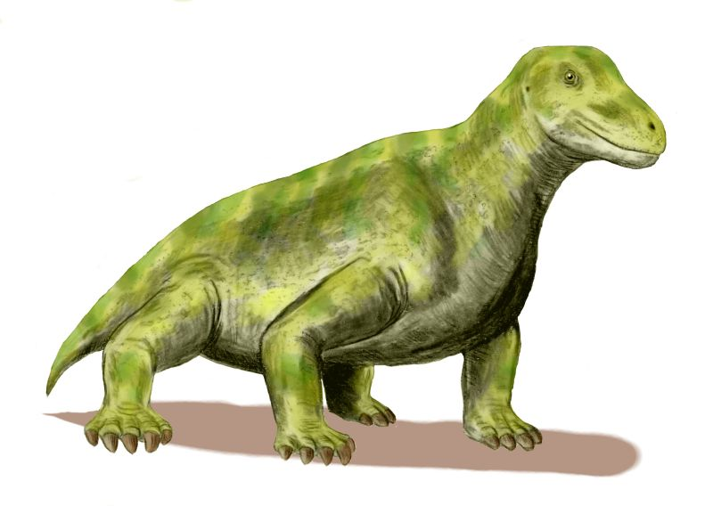

Slide 37
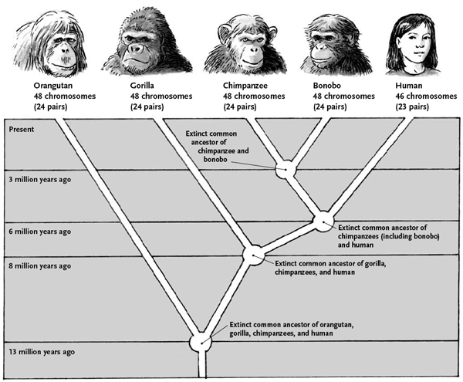

Slide 38
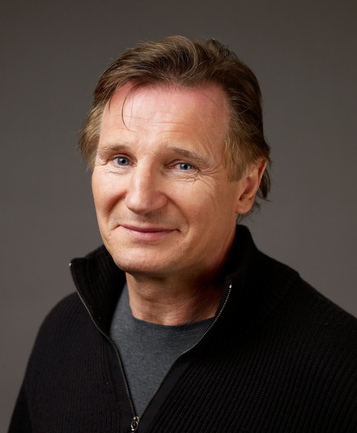
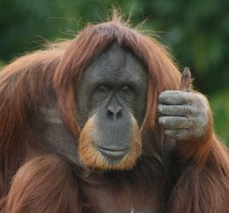
Humans
Orangutans

Slide 39
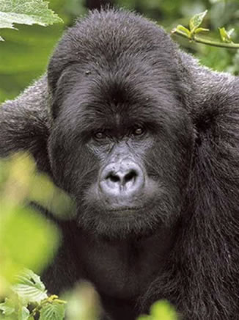
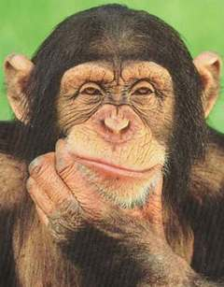
Gorillas
Chimpanzees

Slide 40
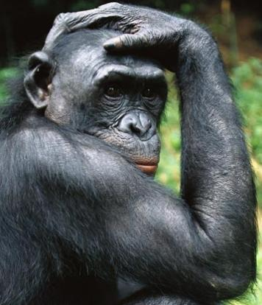
Bonobos

Slide 41
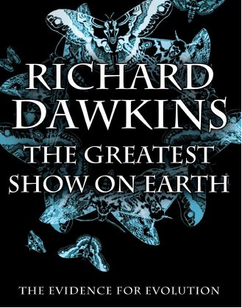
For additional information,
I highly recommend The Greatest Show on Earth: The Evidence for Evolution by
Richard Dawkins

