Slide 1
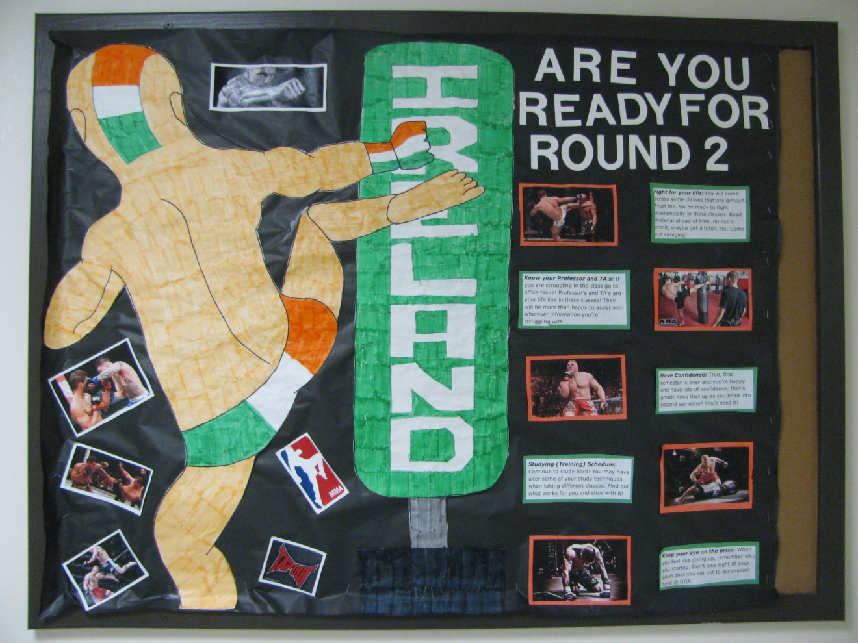
“Are You Ready For Round 2”:
Spring Semester Study Support
Submitted by Wesley Clark, Resident Assistant, The University of Georgia
The purpose of this bulletin board is to inform my residents, who are freshmen, how to excel in their studies come Spring semester!

Slide 2

Fight for your life…
You will come across some classes that are difficult. Trust me! So be ready to “fight” academically in these classes. Read the material ahead, do extra credit, maybe get a tutor, etc. Come out swinging at the beginning of the semester!

Slide 3

Know your Professor and TA’s
If you are struggling in the class go to office hours! Professor’s and TA’s are your life line in these classes! They will be more than happy to assist with whatever information you’re struggling with!

Slide 4

Have Confidence
True, first semester is over and you’re happy and have lots of confidence; that’s great! Keep that up as you head into the second semester! You’ll need it!

Slide 5

Studying (Training) Schedule
Continue to study hard! You may have to alter some your studying techniques when taking different classes. Find out what works for you and stick with it!

Slide 6

Keep your eye on the prize…
When you feel like giving up, remember why you started. Don’t lose sight of your goals that you set out to accomplish here at (college name).

