Slide 1
Tau vs. Pi Submitted by Ben Jenkins, Resident Assistant, Colorado State University

Slide 2
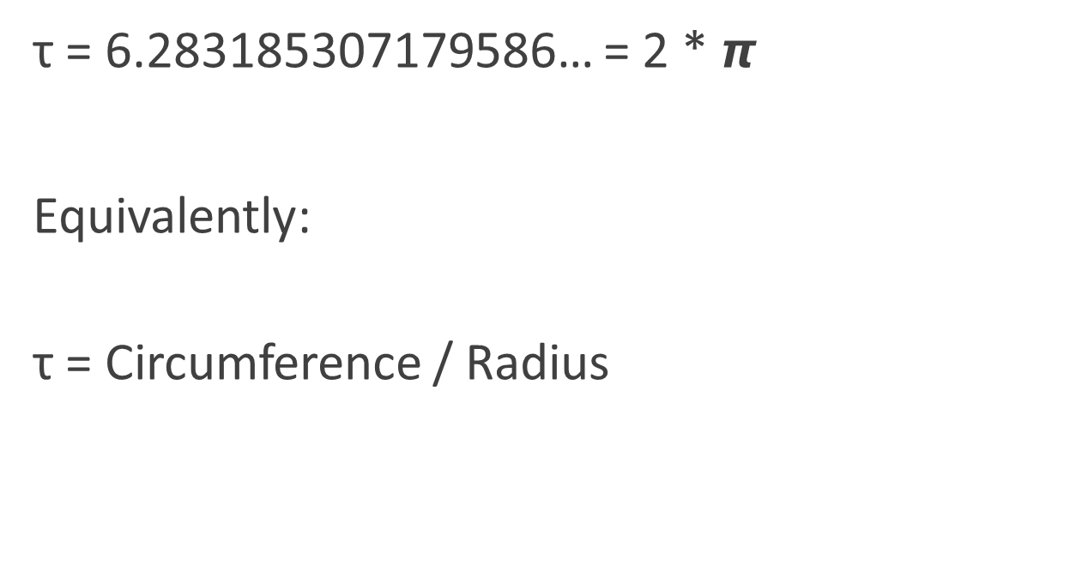
What Is Tau?

Slide 3
What Is Pi?
𝞹 = 3.141592653589…
Equivalently:
𝞹 = Circumference / Diameter

Slide 4
Wait.. People are actually debating about which of the two should be used?
YES!!!
Mathematicians have been arguing for YEARS about which to use in common notation.
There is even a popular book dedicated to the use of tau called “The Tau Manifesto.” (Read it, it’s cool)

Slide 5
The Benefits of Tau
Tau is simple!
If you want to describe a circle in radians, it’s just τ! (None of that 2𝞹 nonsense)
This also means if you want to describe half a circle, it’s τ/2
1/12 of a circle = τ/12
HOW EASY IS THAT?!!

Slide 6
More Benefits of Tau!

Slide 7
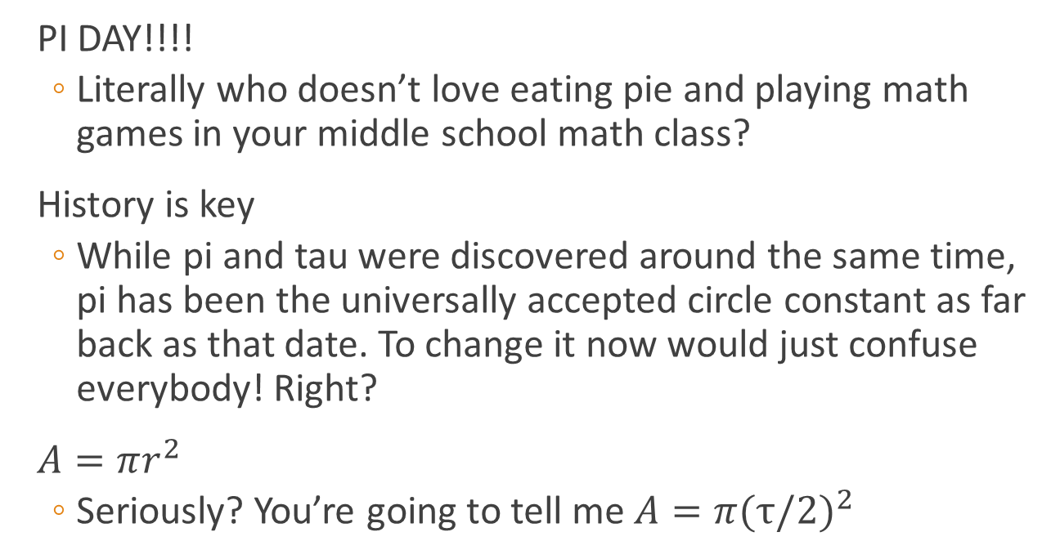
The Benefits of Pi

Slide 8
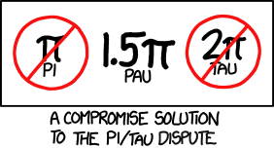
xkcd

Slide 9
Conclusion: Tau Just Make Sense!
Is Tau way more intuitive? – Absolutely
Is Pi more fun to say? – Yeah I guess..
Is the choice of one or the other going to completely change the fate of humanity? – Maybe? I don’t know but I guess it’s not out of the question.
Is Pi or tau the better option? – That is up to you to decide.

