Slide 1
Arabian Nights Bulletin Board
Tim Thompson & Bryn Holdsworth, RAs, 8th Floor
Manhattan School of Music
Submitted by Wadner Auguste
Director of Residence Life
Manhattan School of Music

Slide 2
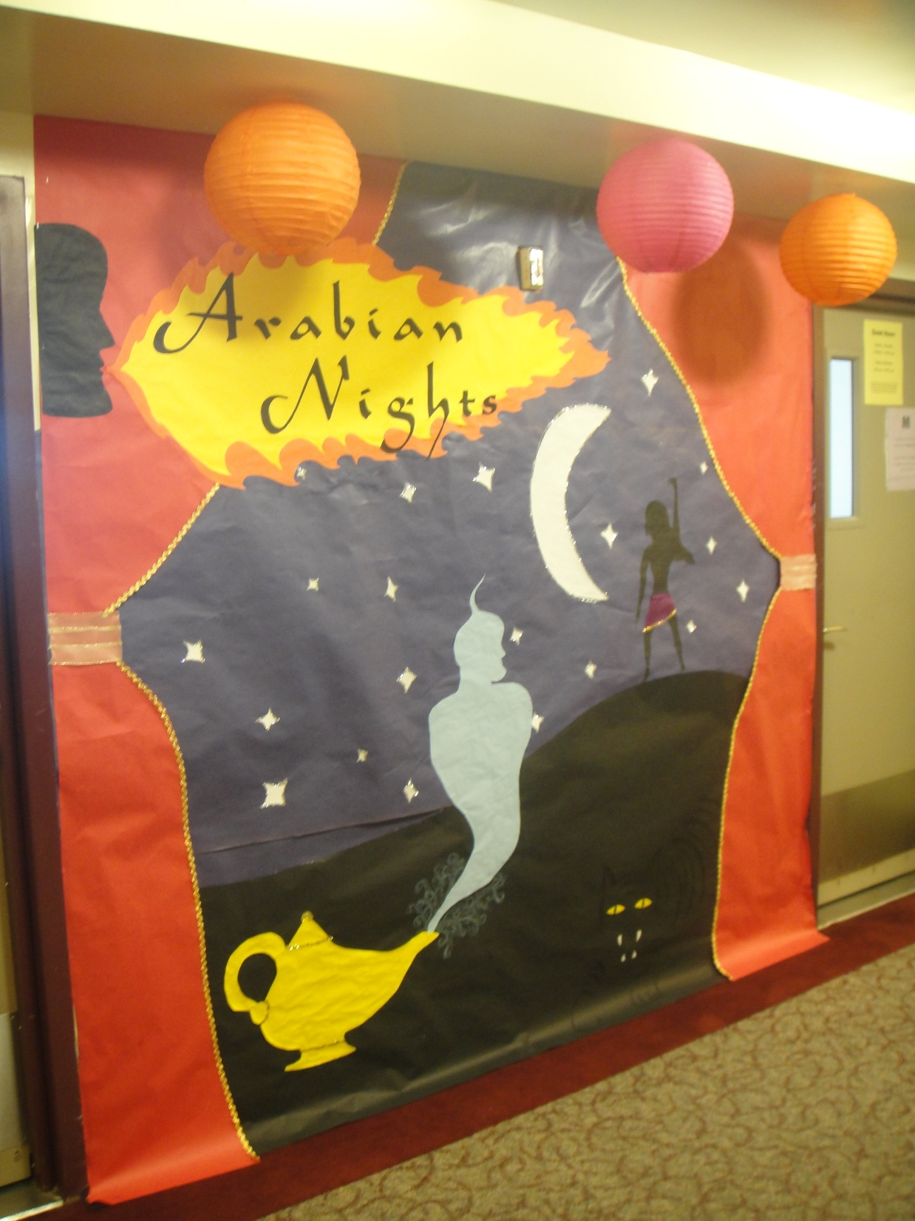

Slide 3
