Slide 1
Applications for I-Phones and Androids: Enhance Success in College
Eric Hotchkiss
Residence Director
SUNY Fredonia

Slide 2
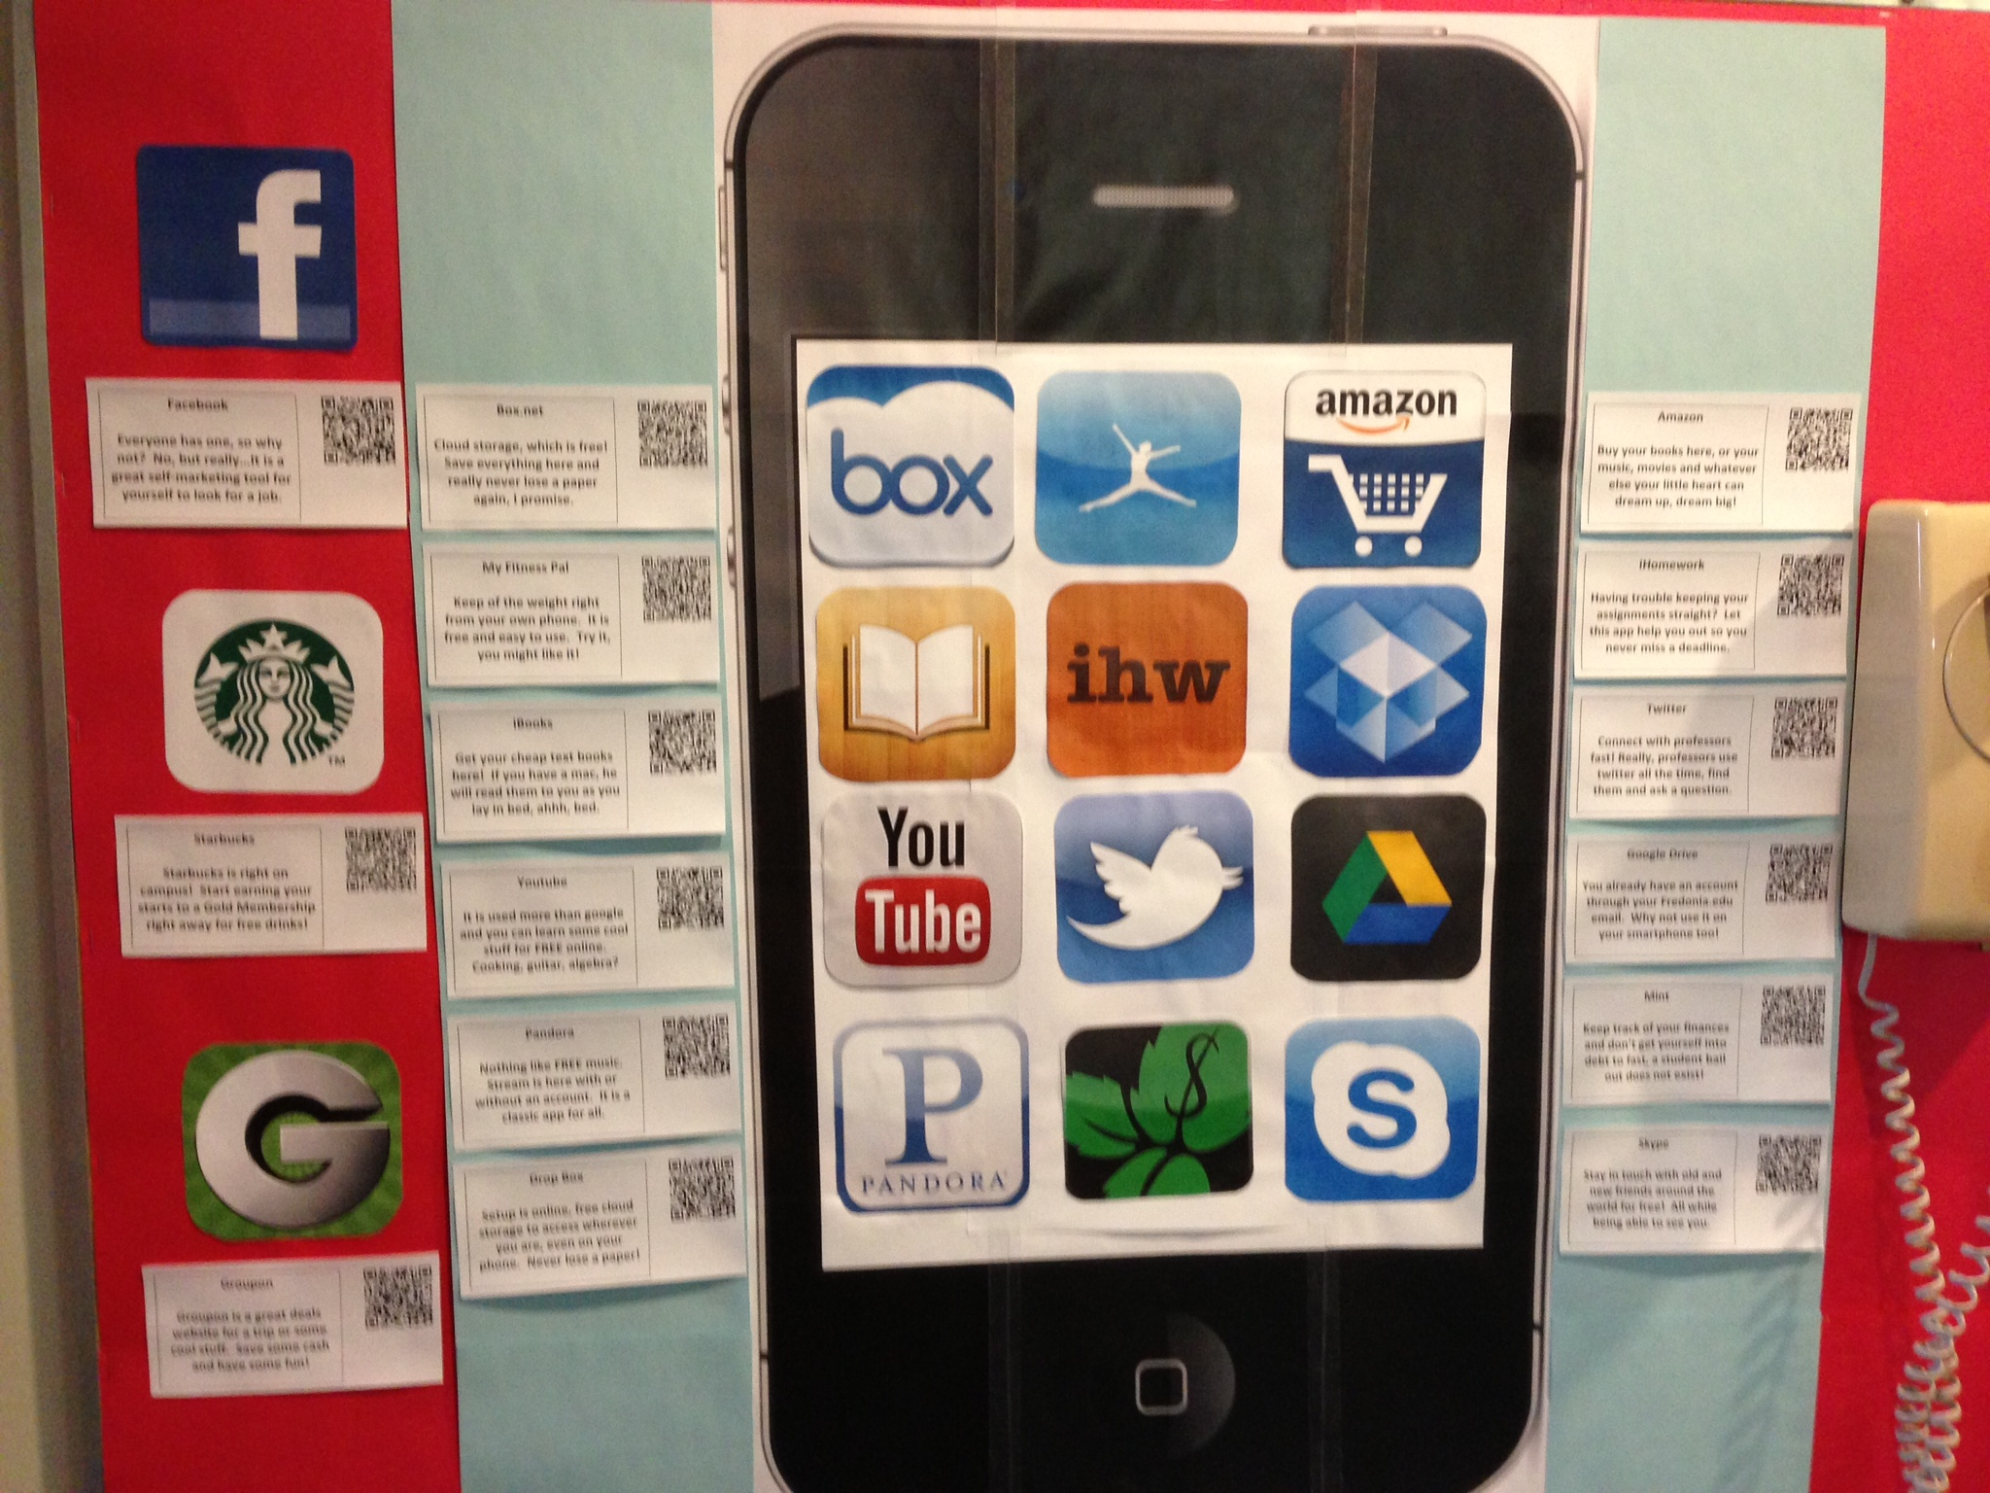

Slide 3
Note from the Author
The bulletin board with the iPhone in the center educates students about all sorts of applications students can use while at college. They range from Amazon.com for text books to iHomework which helps students budget time for homework assignments short term and long term.
A short description describing what each application does and a QR barcode was placed near each icon so that students could understand the value of and easily download each application. This board is geared toward iOS phones, but the apps are also available on Android phones.

