Slide 1
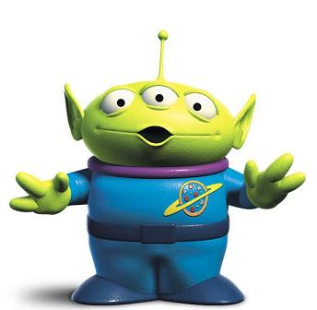
Toy Story Green Alien Door Tags
By: Courtney Cary Bloomsburg University of Pennsylvania Mount Olympus Apartment- Community Assistant 2013

Slide 2
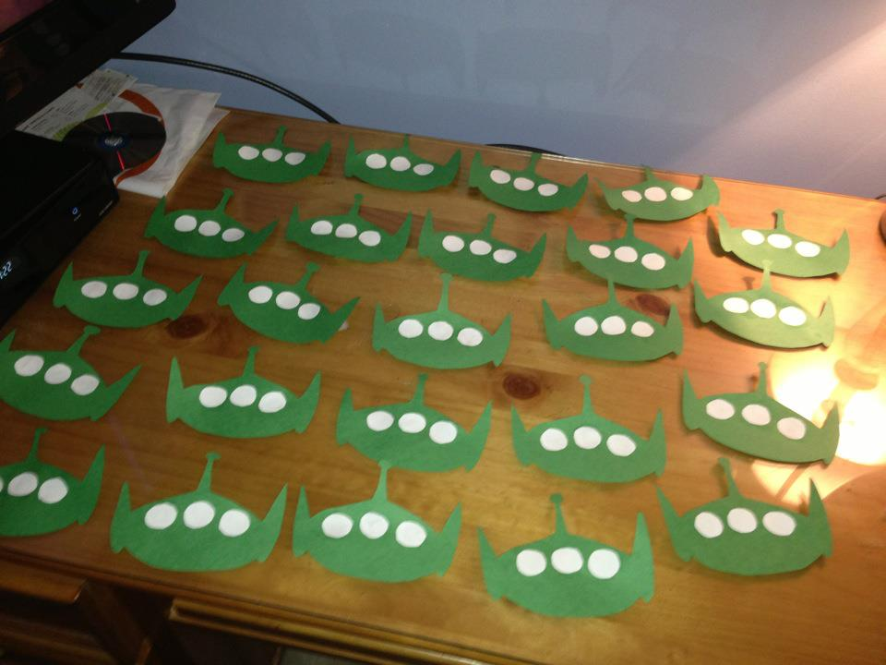
Step 1: Head and Eyes

Slide 3
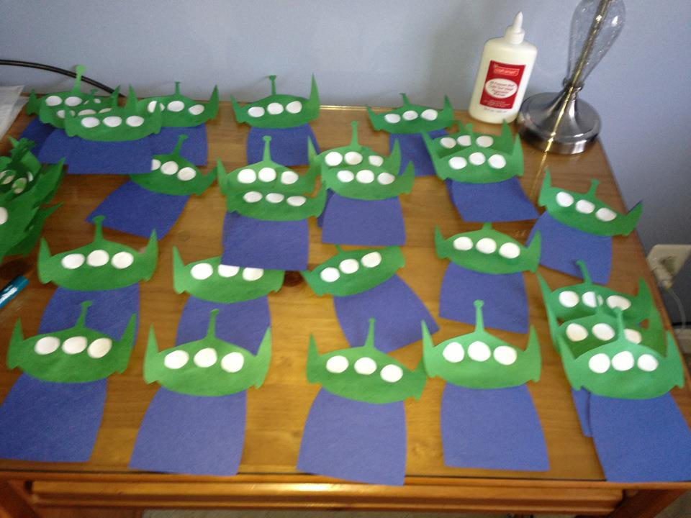
Step 2: Body

Slide 4
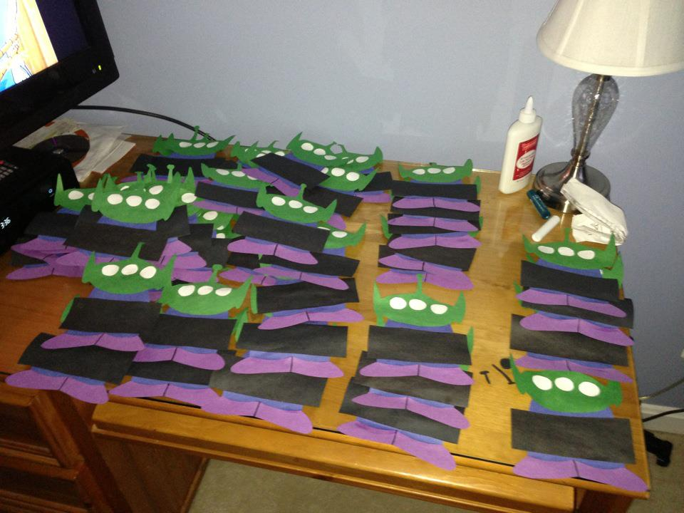
Step 3: Feet

Slide 5
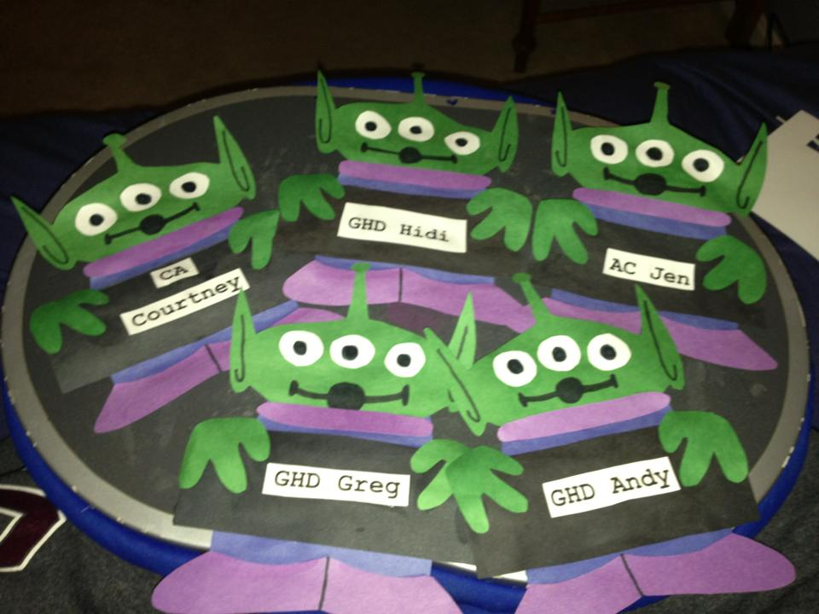
Step 4: Hands, Face, and Names

