Slide 1
The Nightmare Before Christmas Bulletin Board & Door Decs
Alasha Fox, RA, 5th floor
Manhattan School of Music
Submitted by Wadner Auguste, Director of Residence Life, Manhattan School of Music

Slide 2
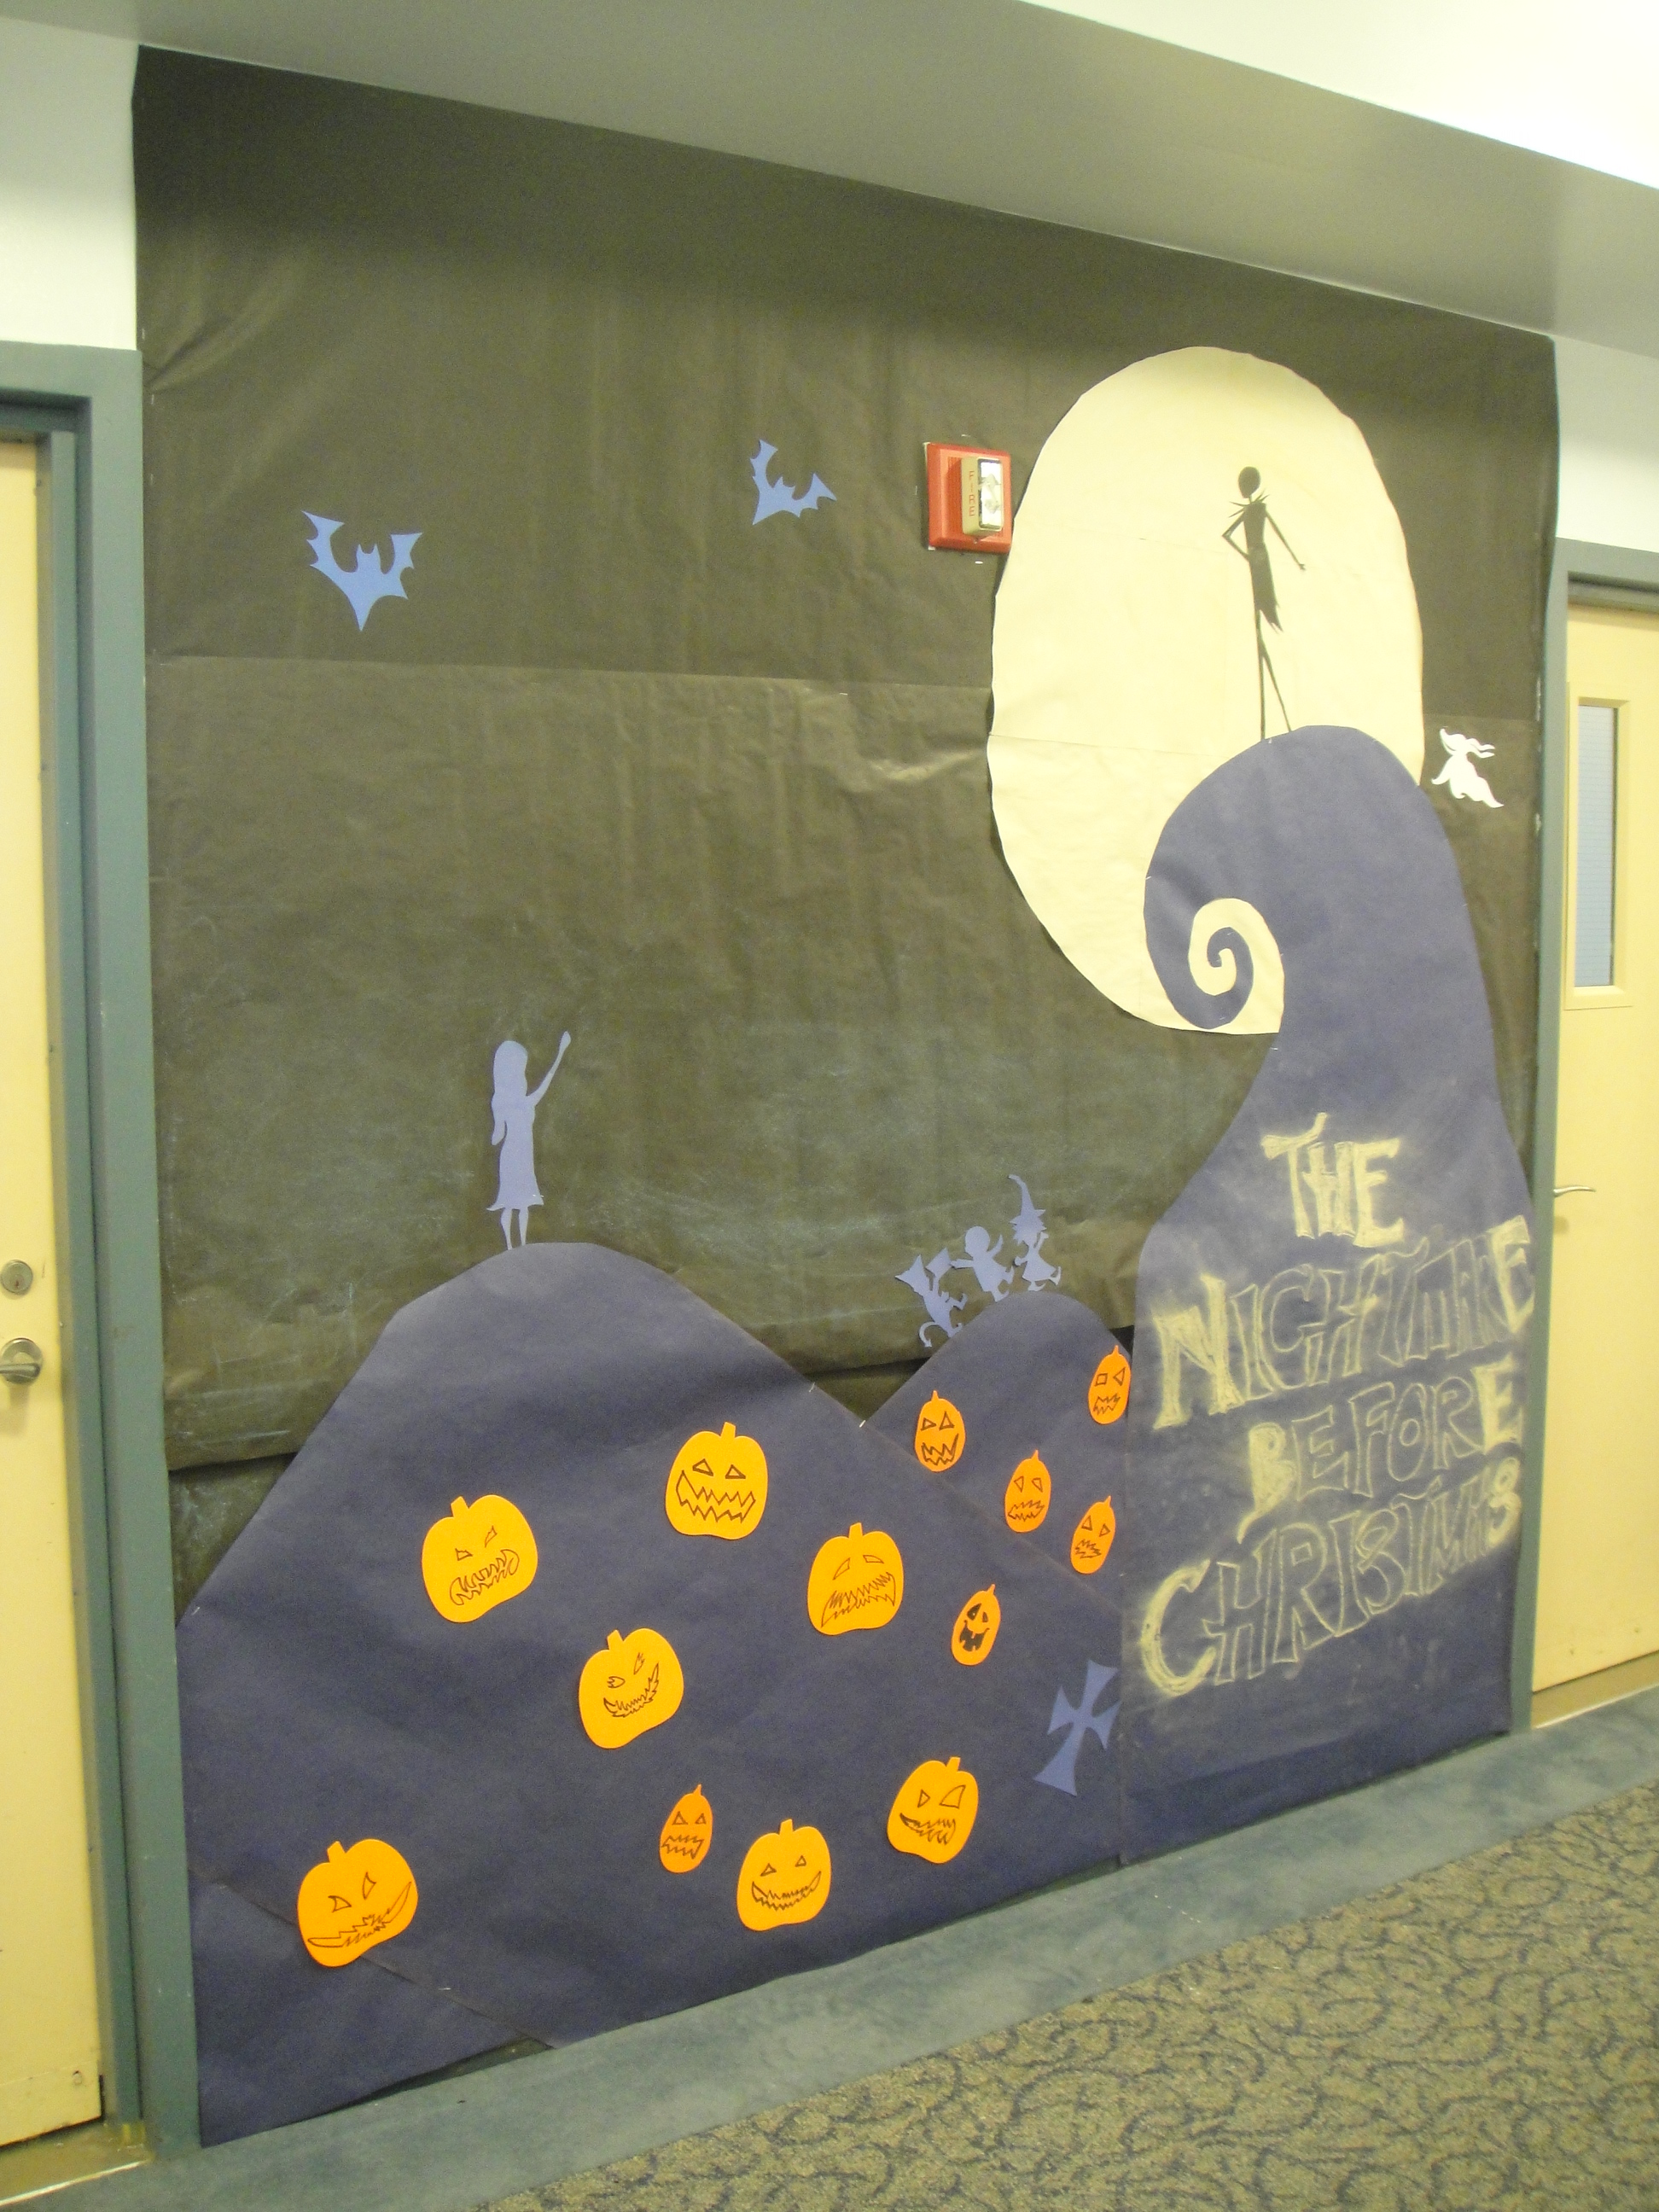

Slide 3
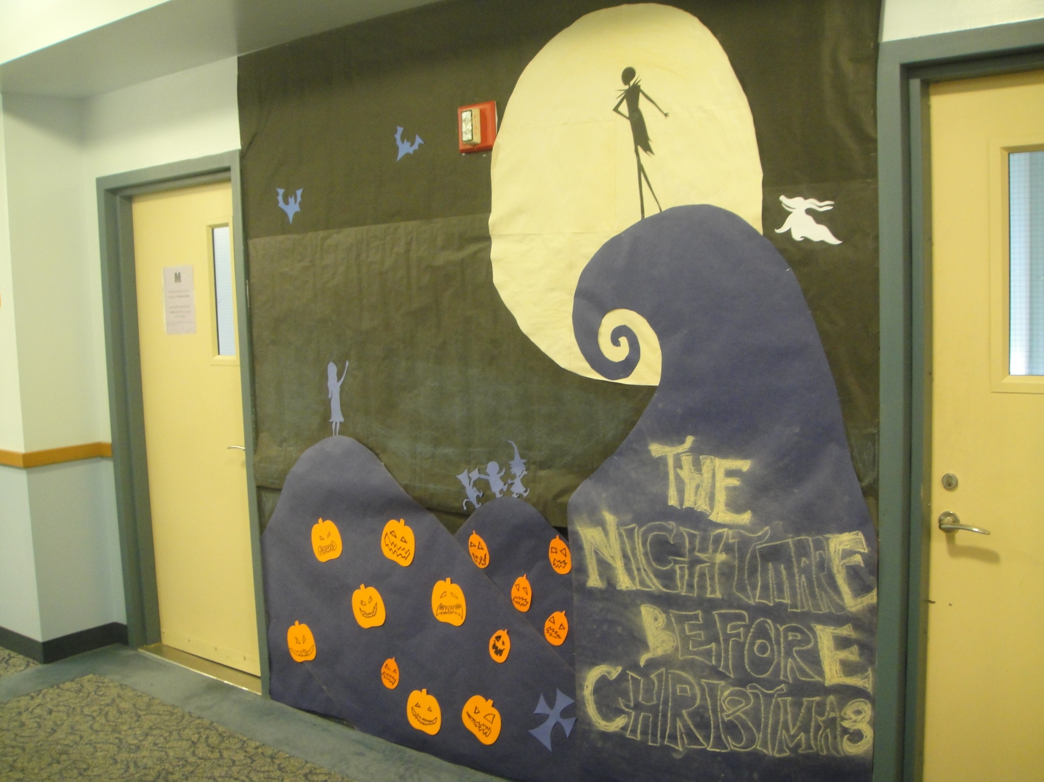

Slide 4
