Slide 1
The Real World Door Decoration Idea
Amanda Drew
Resident Assistant
Anna Maria College

Slide 2
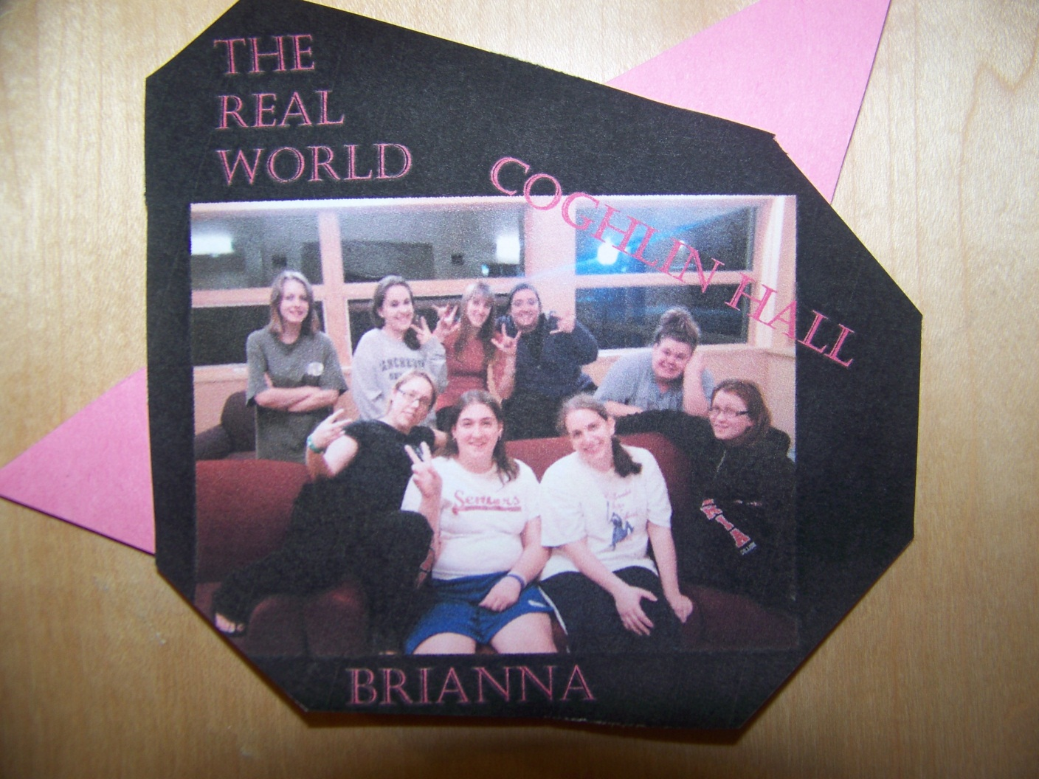

Slide 3
The Real World Door Dec
This was a door tag idea that I had that I thought would be different and personal for my residents. I took the idea of the show "The Real World" and took a "cast picture" of my residents, then titled it "The Real World: Coghlin Hall". This was all done on the computer, then I took construction paper and cut different shapes to create a nice backing to the door tag. My residents loved this idea, and it helped create a great community within the hall.

