Slide 1
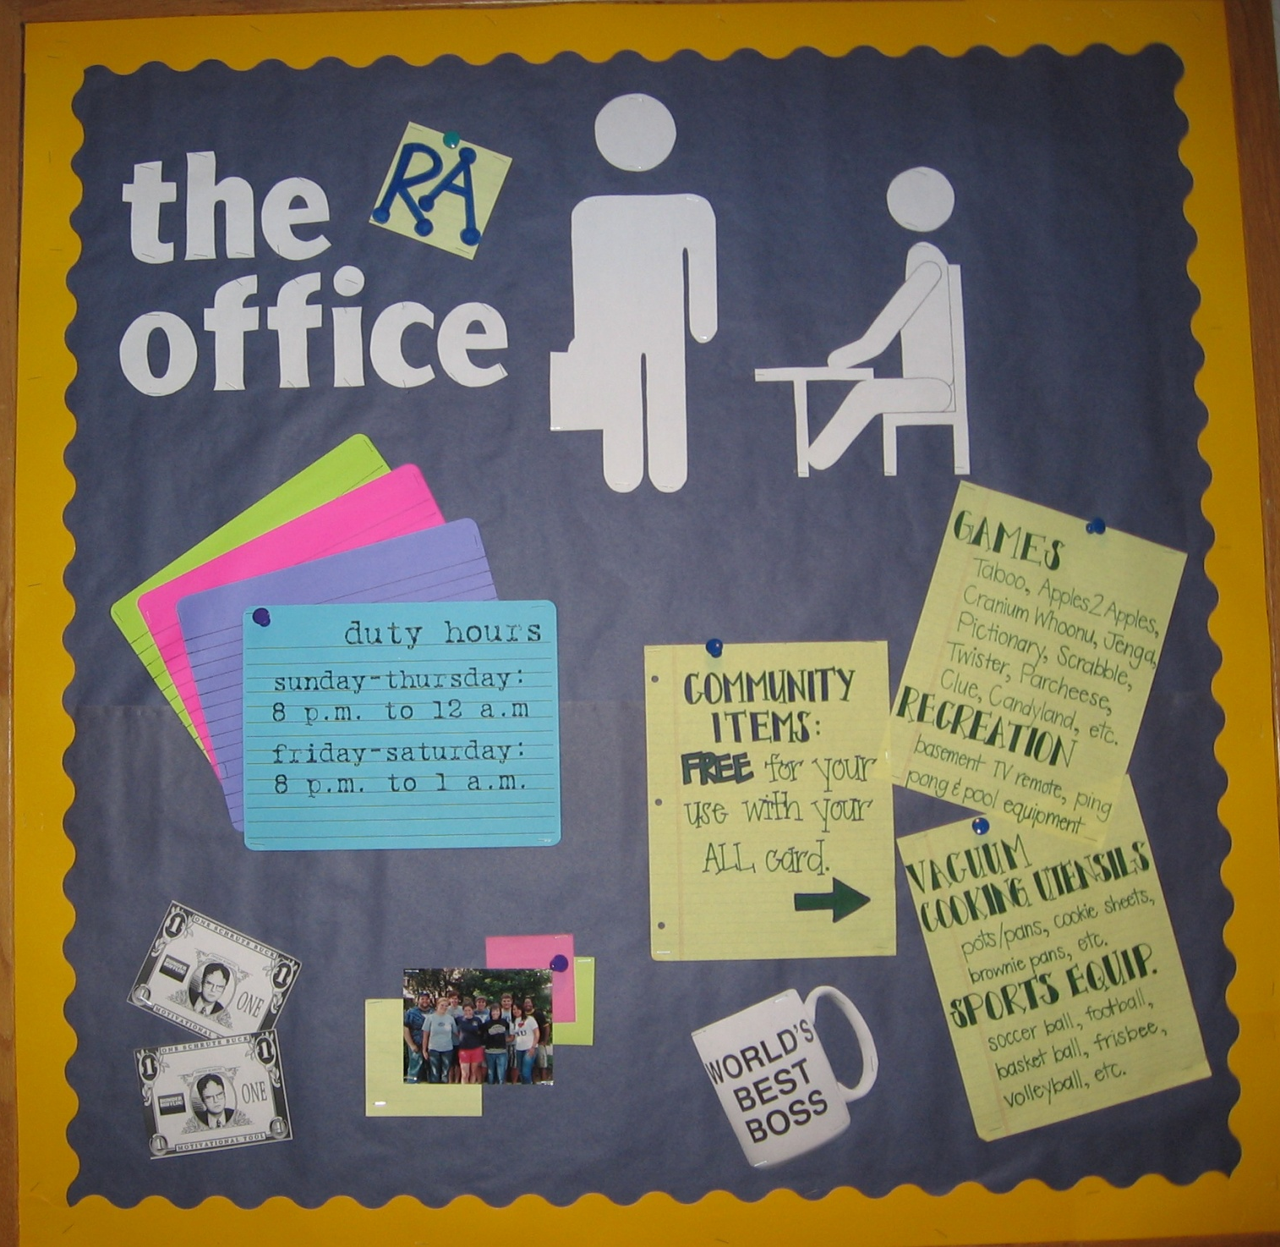
Let your residents know all about your RA Office by imitating “The Office” TV theme
INFO TO INCLUDE:
Duty hours
RA names
Things to rent from the RA office

Slide 2
Submitted by Ashley Sroufe Senior Resident Assistant Xavier University, Cincinnati, Ohio

