Slide 1
Random Acts of Kindness Bulletin Board: An example of taking an idea from ResLife.net and expanding it a bit
Cheyenne Harrington, RA
Submitted By Beth Hill, Associate Director of Residence Life
Western New England College
Tweaked from idea previously submitted

Slide 2
Notes about Random Acts of Kindness Bulletin Board
The photos show the following: 1. full board 2. close-ups so you can see some specific content 3. supplemental posters on the floor 4. the note from two residents to two athletes...an outcome This bulletin board allowed for interaction from residents with the supplemental posting of tag strips that you usually see for "room for rent“ advertising posters. Residents added notes of kindness to others. See the example of the letter from students who wrote a letter to the men about their winter sports season...
This idea was taken and expanded from a previous example shared on ResLife.net. This is an example of how an idea can be edited, expanded, or combined to fit another community at another time.

Slide 3
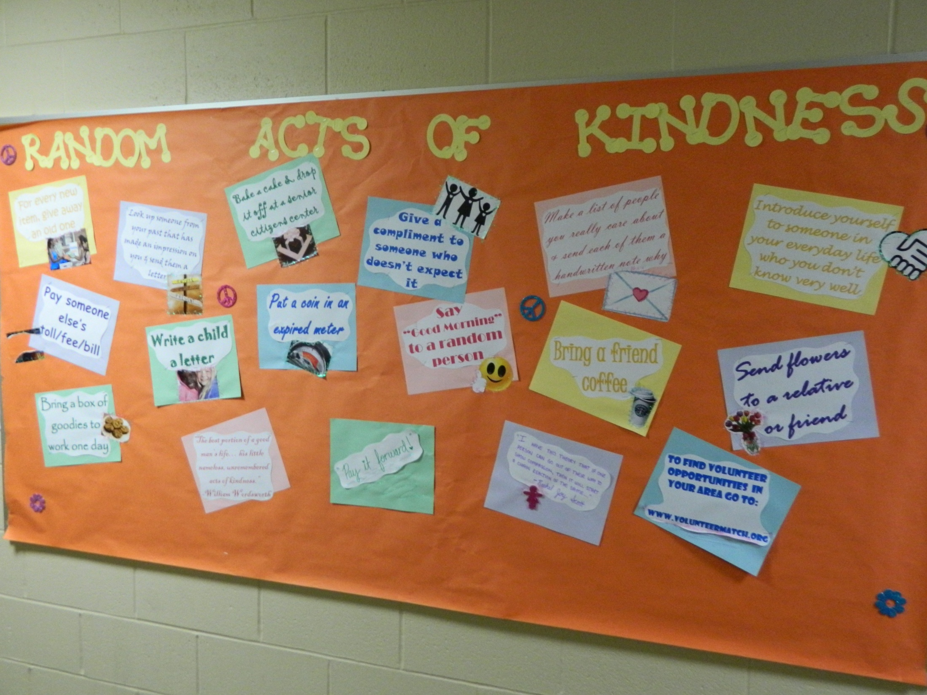

Slide 4
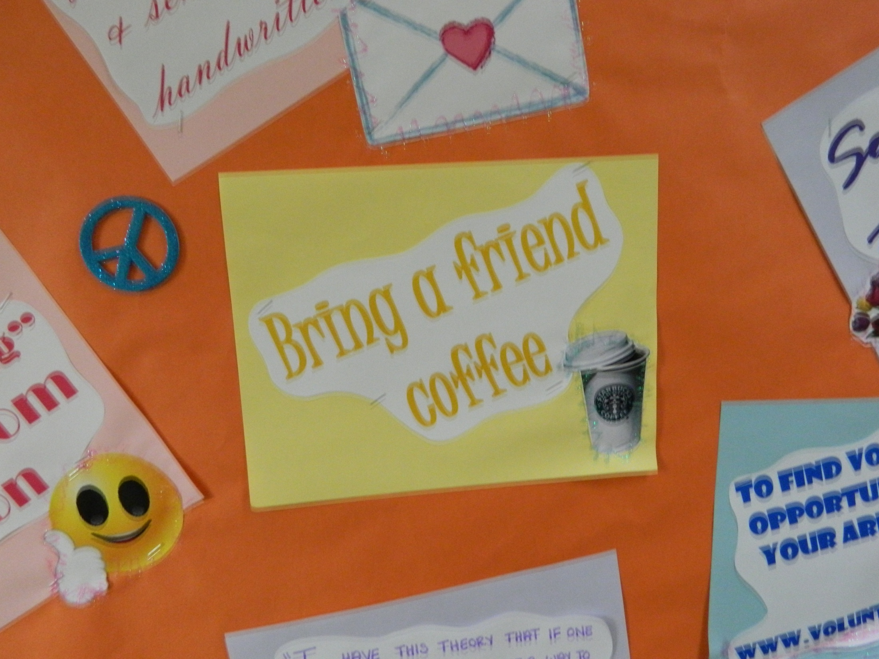

Slide 5
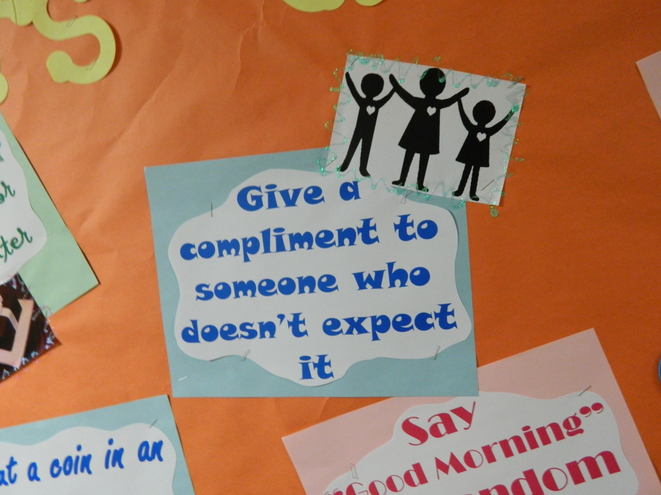

Slide 6
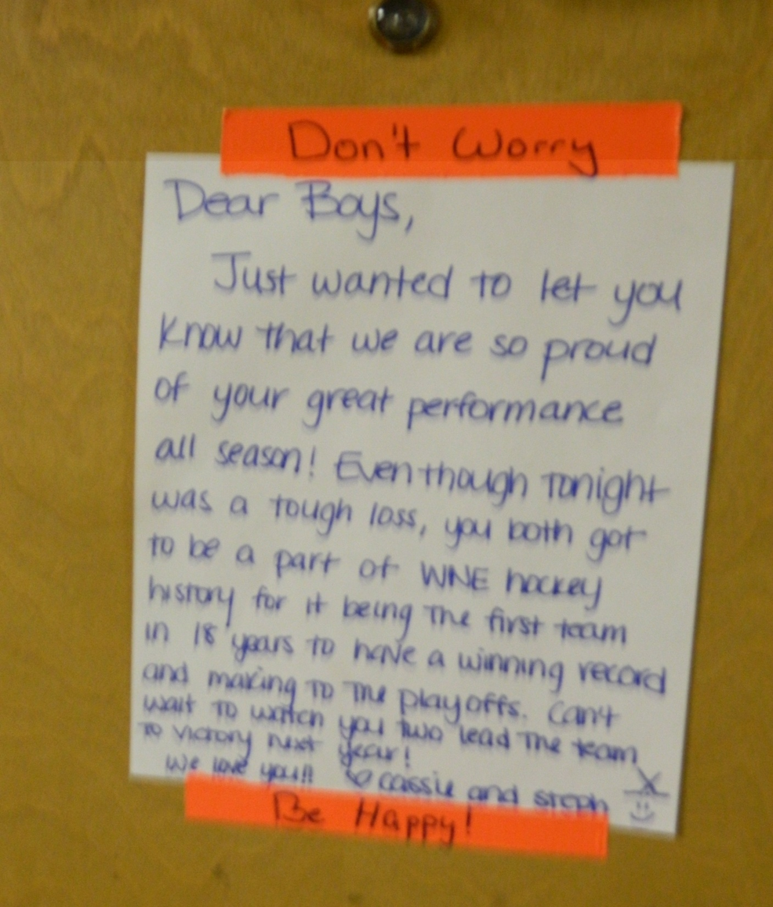

Slide 8
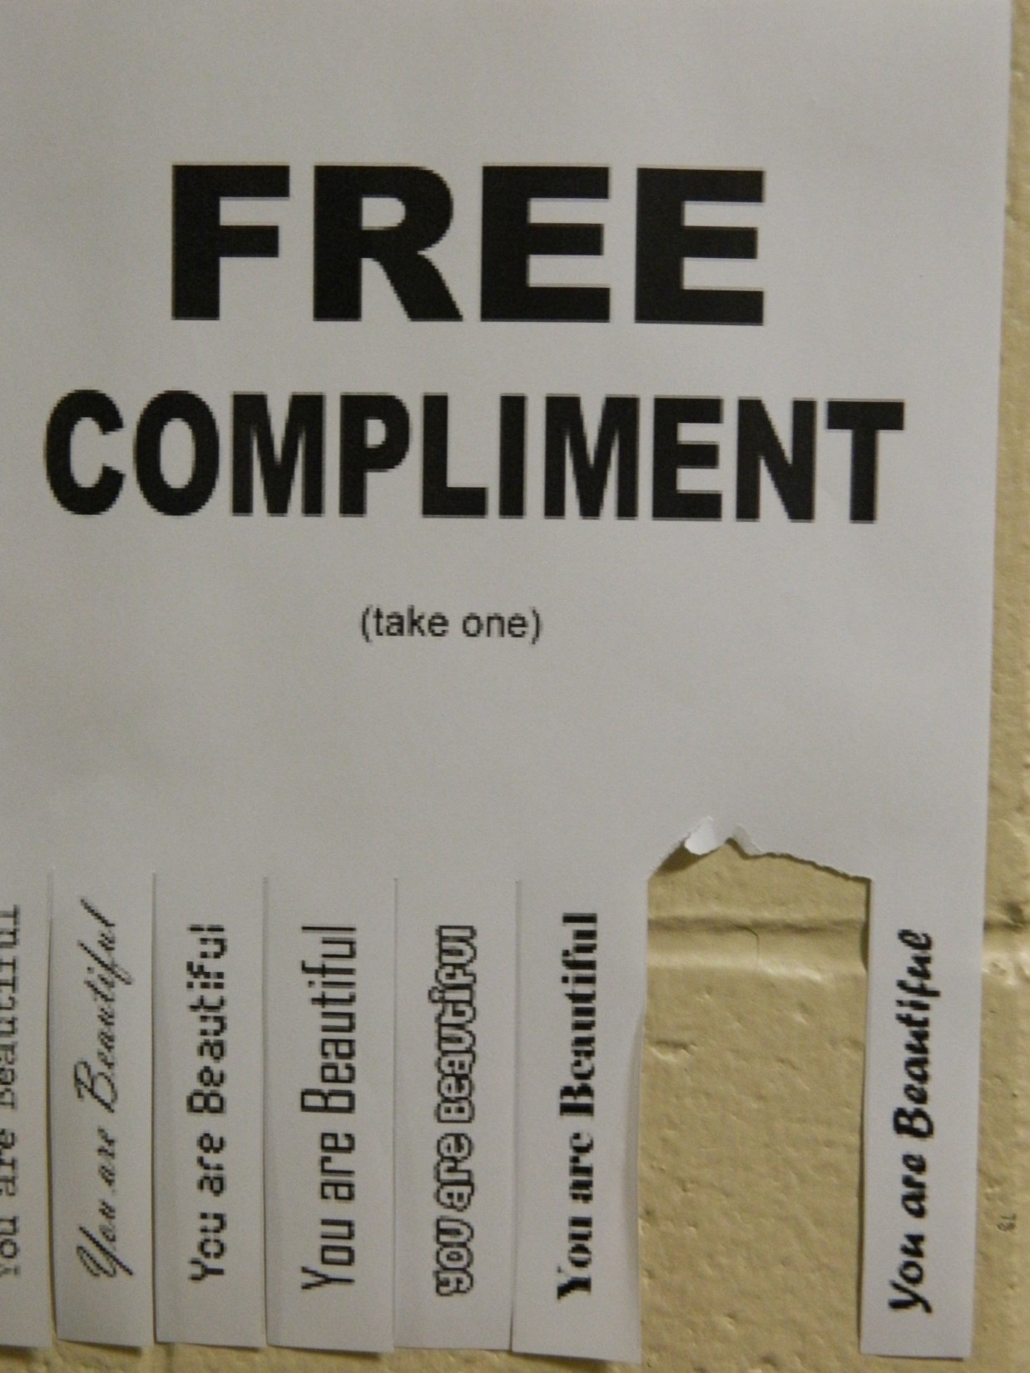

Slide 9
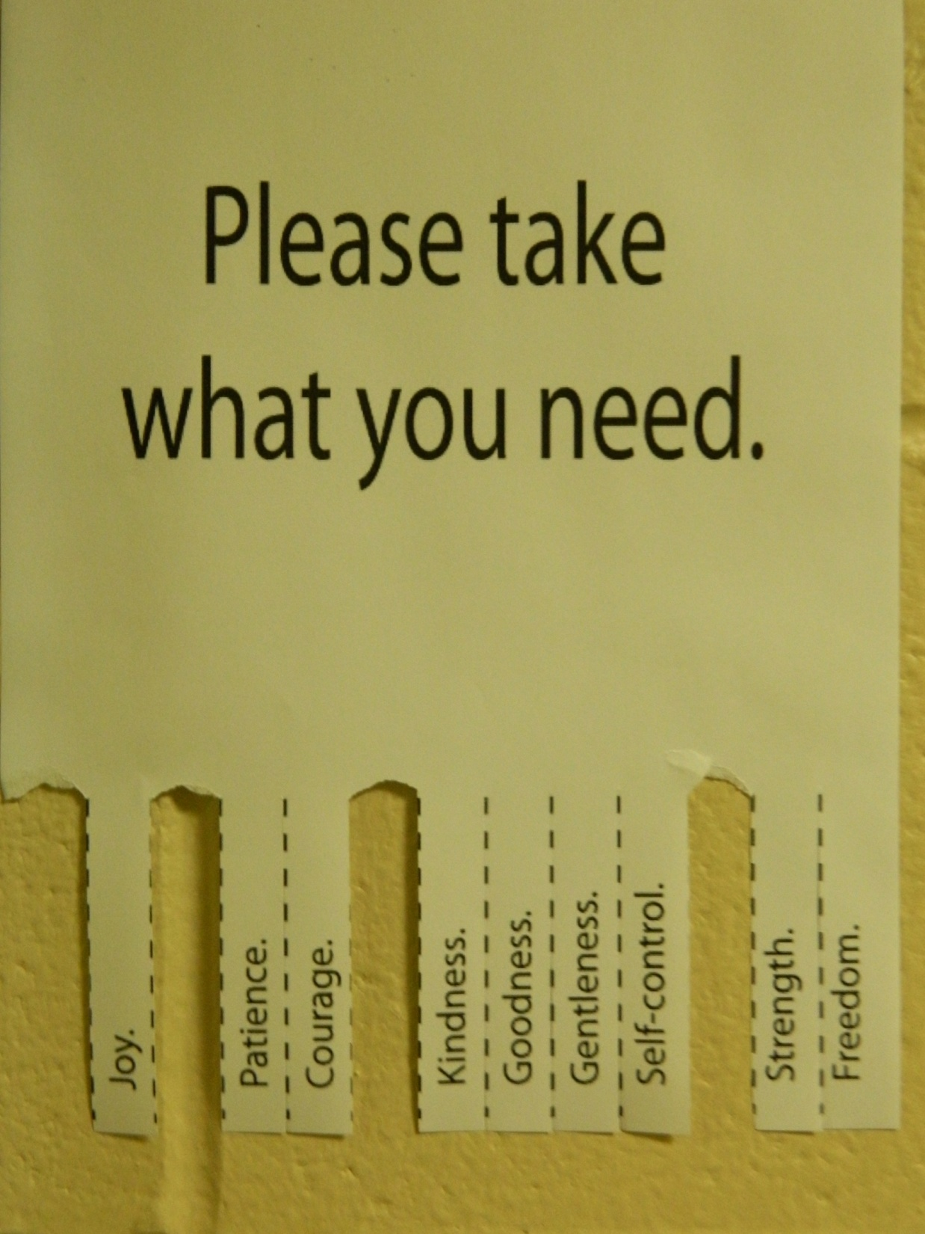

Slide 10
Notes from submittor
This board demonstrates that a bulletin board does make a difference and the students do read, and act, on the messages!

