Slide 1
Puzzle Piece Welcome Sign, Welcome Bulletin Board, and Door Decorations
Resident Assistant
Lock Haven University
Pennsylvania
Featured Institution
Submitted by Wendy Walsh, Student Life Coordinator

Slide 2
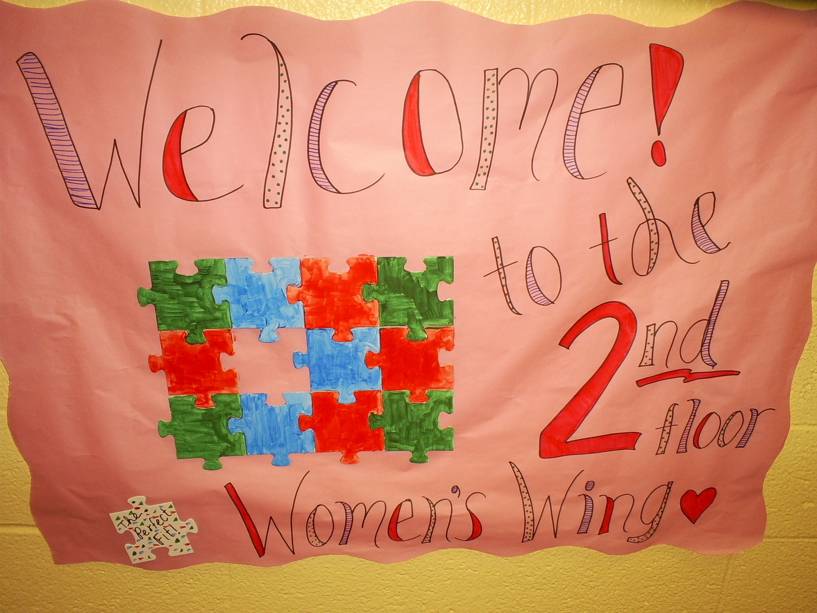

Slide 3
Note
This welcome poster can be turned into a welcome bulletin board with door decorations.
Each resident’s name is placed on a puzzle piece with or without “The Perfect Fit” written under their name. The puzzle pieces with resident names can be placed around the Welcome Bulletin Board to serve as a boarder. A second puzzle piece with the resident’s name can also be placed on the resident’s door as a door decoration.

Slide 4
