Slide 1
Door Tag and Bulletin Board: Maps and Cars
Submitted by Alexandria Boyer
Saint Mary’s College

Slide 2
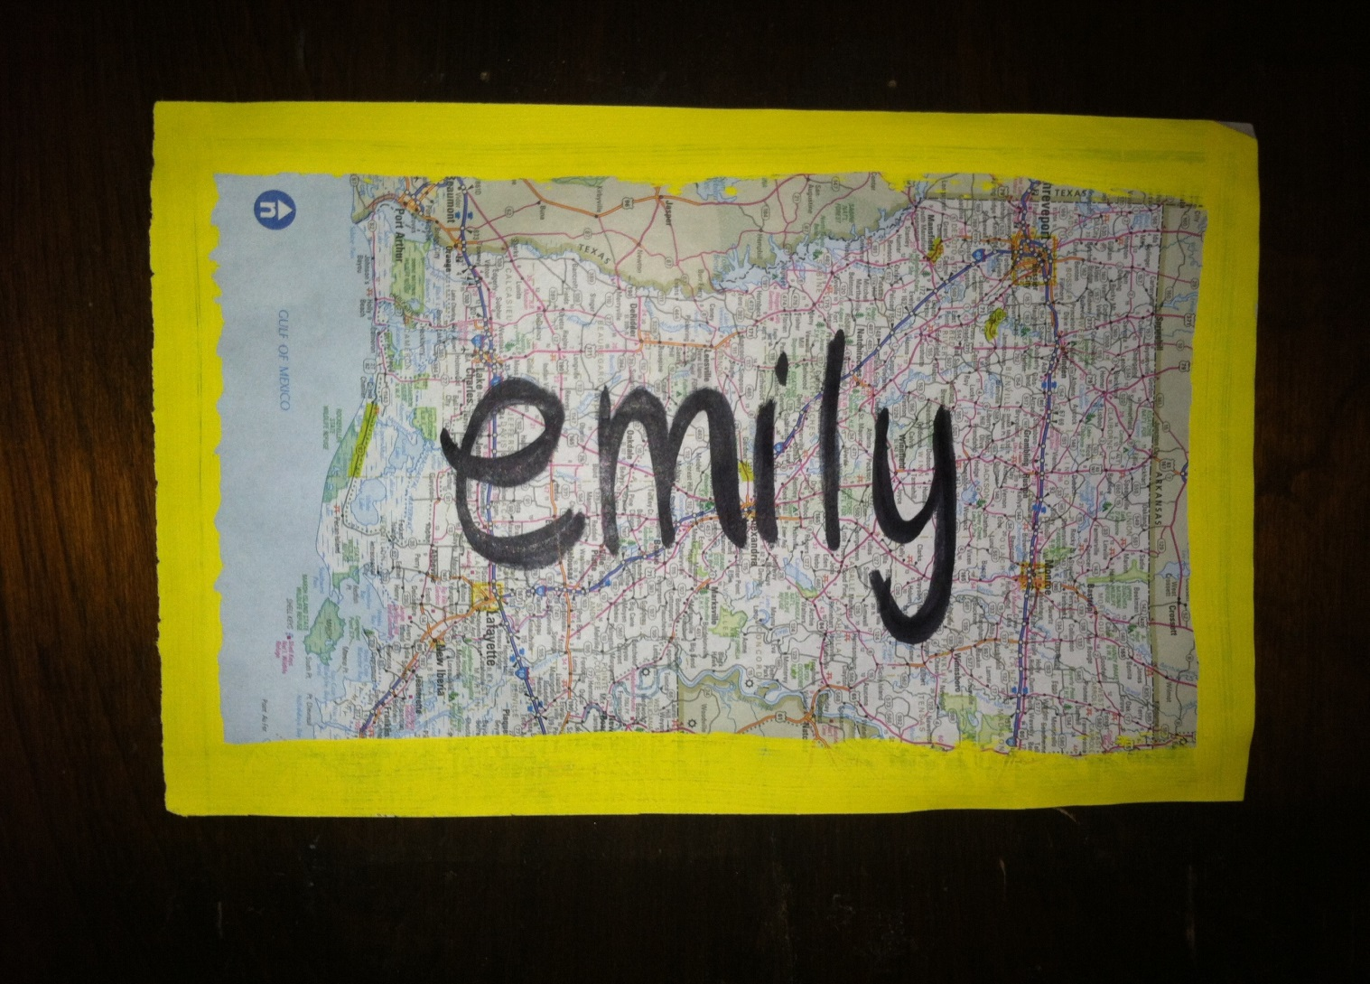
Door Decs

Slide 3
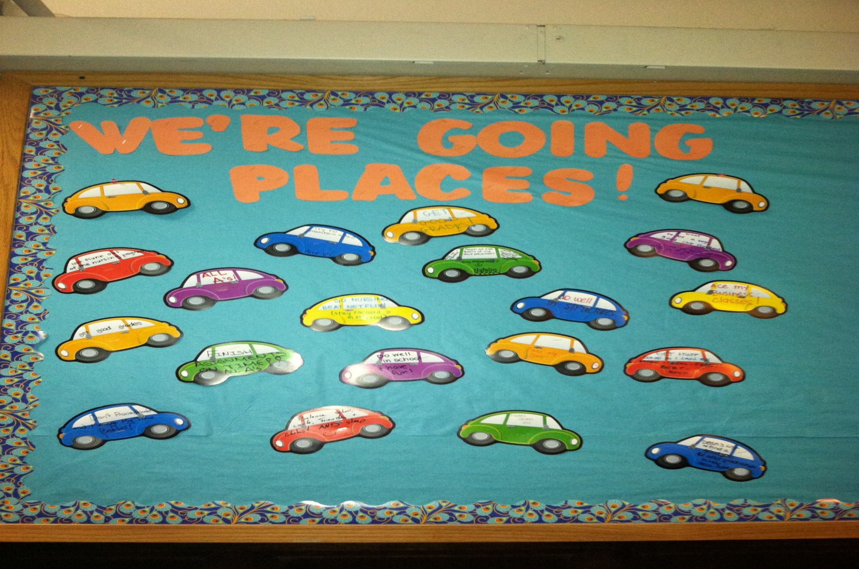
Bulletin Board

