Slide 1
Cool Images from the Hubble Telescope
Compiled by Chris Wolfram, RA University of Maryland-College Park

Slide 2
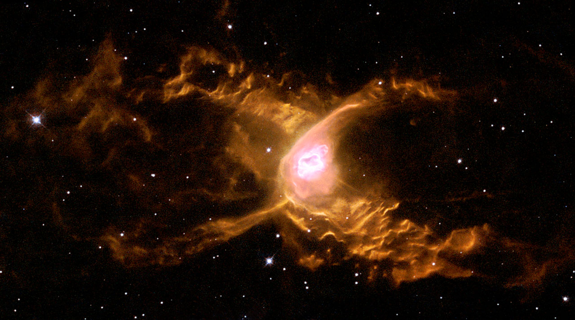
The Red Spider Nebula
Huge waves are sculpted in this two-lobed nebula some 3000 light-years away in the constellation of Sagittarius. This warm planetary nebula harbors one of the hottest stars known and its powerful stellar winds generate waves 100 billion kilometers high. The waves are caused by supersonic shocks, formed when the local gas is compressed and heated in front of the rapidly expanding lobes. The atoms caught in the shock emit the spectacular radiation seen in this image.

Slide 3
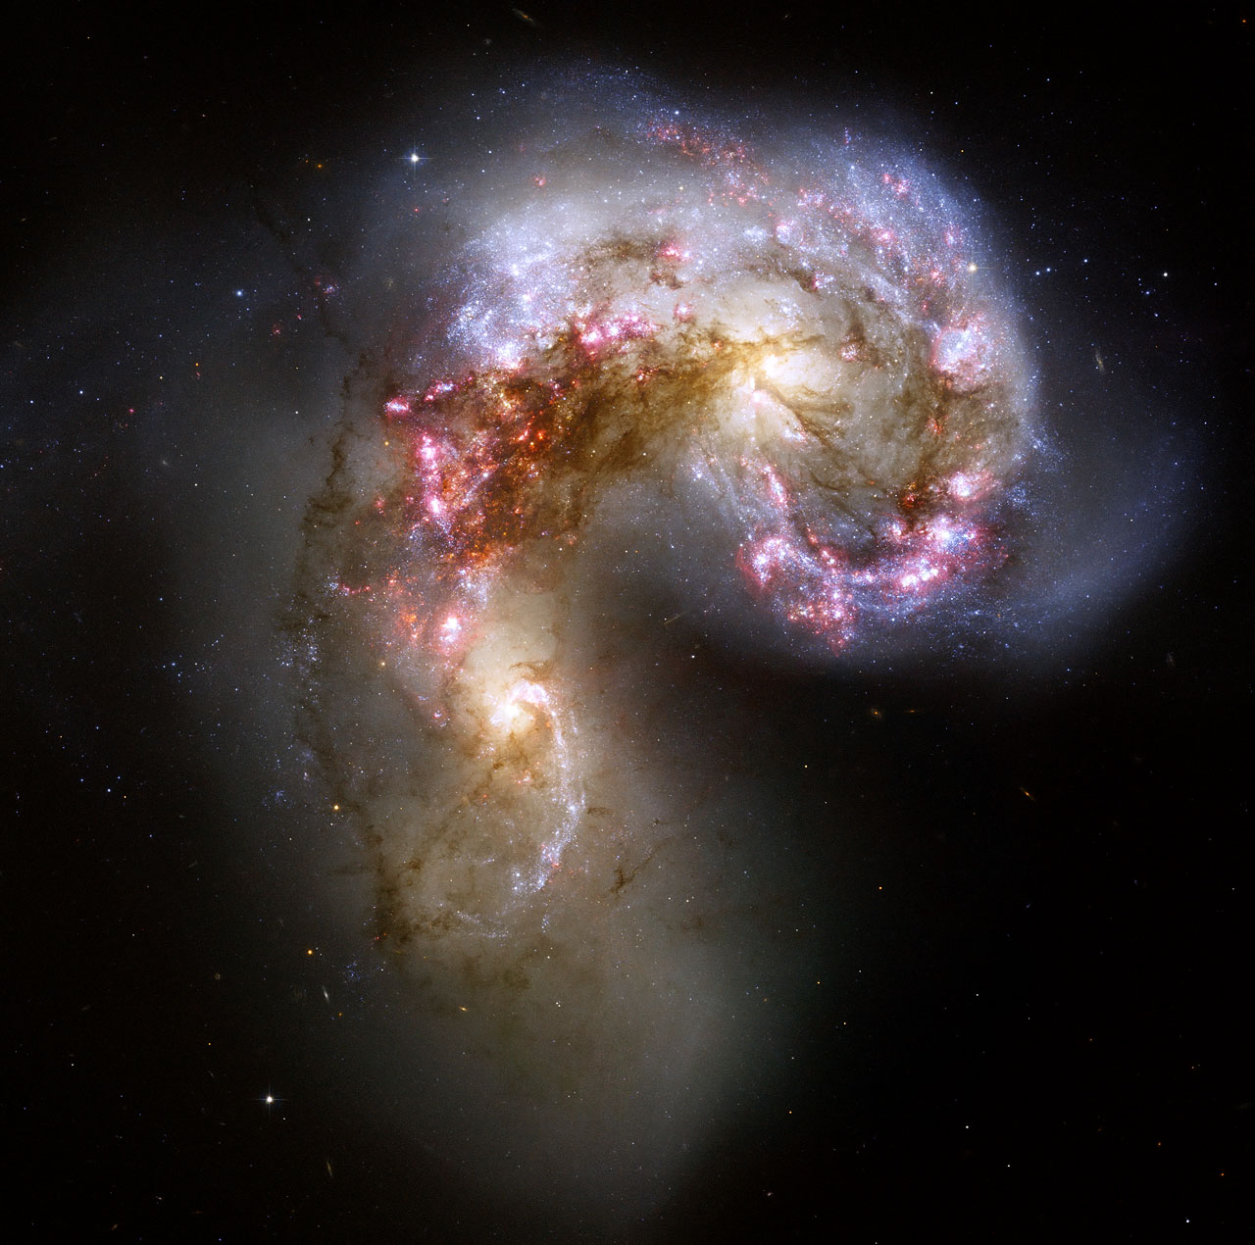
Antennae Galaxies
This Hubble image of the Antennae galaxies is the sharpest yet of this merging pair of galaxies. As the two galaxies smash together, billions of stars are born, mostly in groups and clusters of stars. The brightest and most compact of these are called super star clusters.

Slide 4
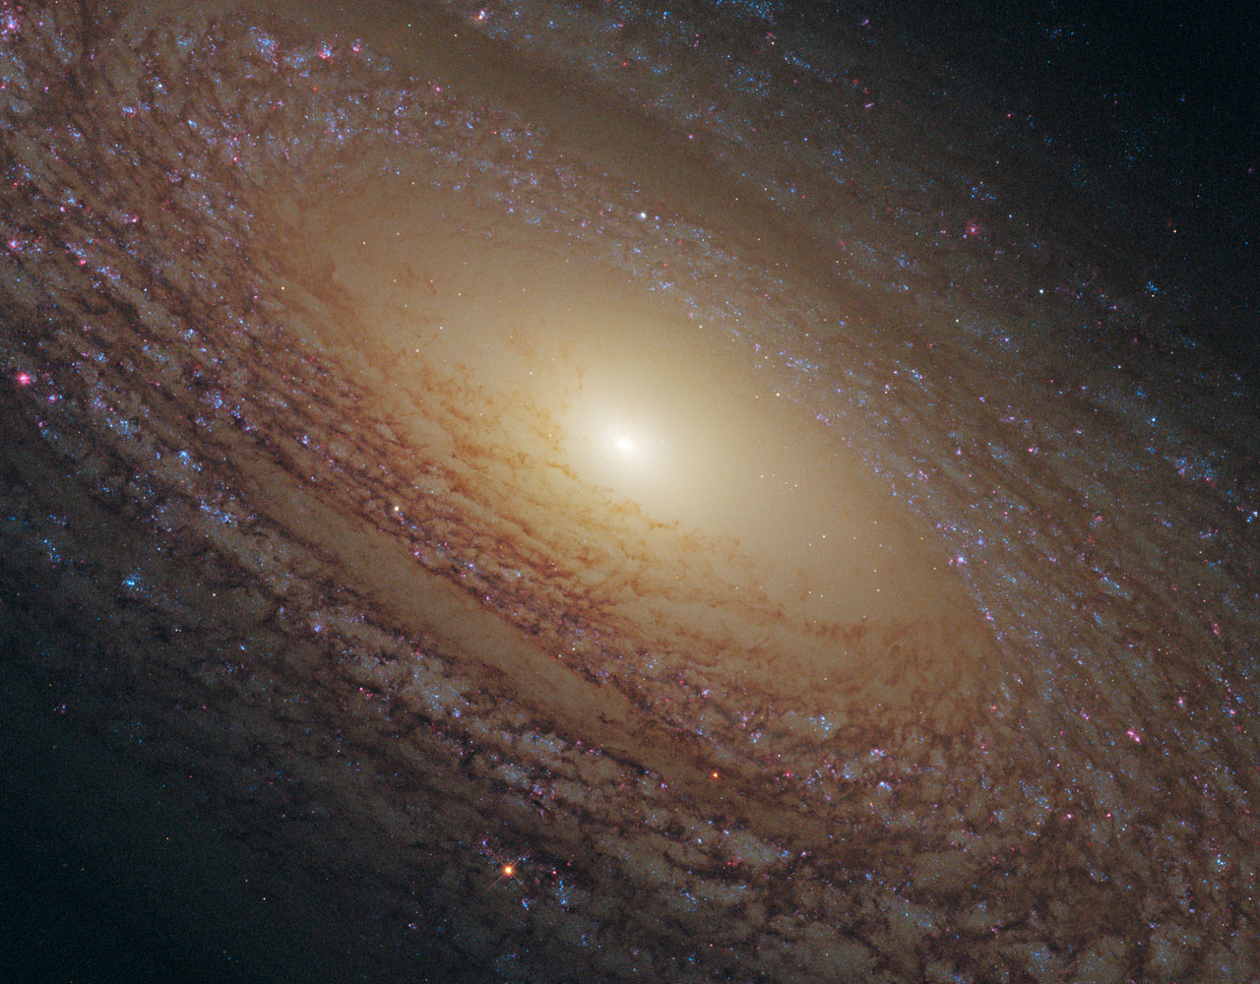
Flocculent spiral NGC 2841
There is still much that astronomers don’t understand about star formation, such as what triggers it and how the properties of stellar nurseries vary according to the composition and density of gas present. The driving force behind star formation is particularly unclear for a type of galaxy called a flocculent spiral, such as NGC 2841 shown here, which features short spiral arms rather than prominent and well-defined galactic limbs.

Slide 5
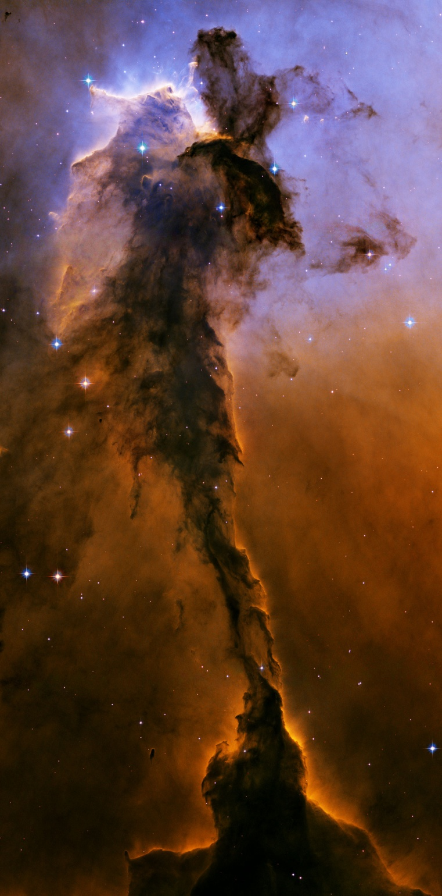
Stellar spire in the Eagle Nebula
This object is a billowing tower of cold gas and dust rising from a stellar nursery called the Eagle Nebula. The soaring tower is 9.5 light-years or about 90 trillion kilometers high, about twice the distance from our Sun to the next nearest star.
Stars in the Eagle Nebula are born in clouds of cold hydrogen gas that reside in chaotic neighborhoods, where energy from young stars sculpts fantasy-like landscapes in the gas. The tower may be a giant incubator for those newborn stars. A torrent of ultraviolet light from a band of massive, hot, young stars [off the top of the image] is eroding the pillar.
The starlight also is responsible for illuminating the tower's rough surface. Ghostly streamers of gas can be seen boiling off this surface, creating the haze around the structure and highlighting its three-dimensional shape. The column is silhouetted against the background glow of more distant gas.

Slide 6
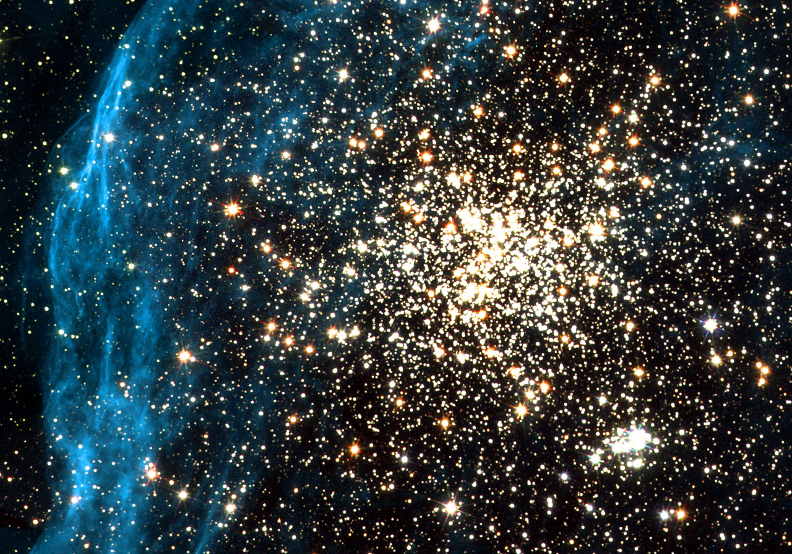
Double Star Cluster
Located in the Large Magellanic Cloud, one of our neighbouring dwarf galaxies, this young globular-like star cluster is surrounded by a pattern of filamentary nebulosity that is thought to have been created during supernova blasts. It consists of a main globular cluster in the centre and a younger, smaller cluster, seen below and to the right, composed of extremely hot, blue stars and fainter, red T-Tauri stars. This wide variety of stars allows a thorough study of star formation processes.

Slide 7
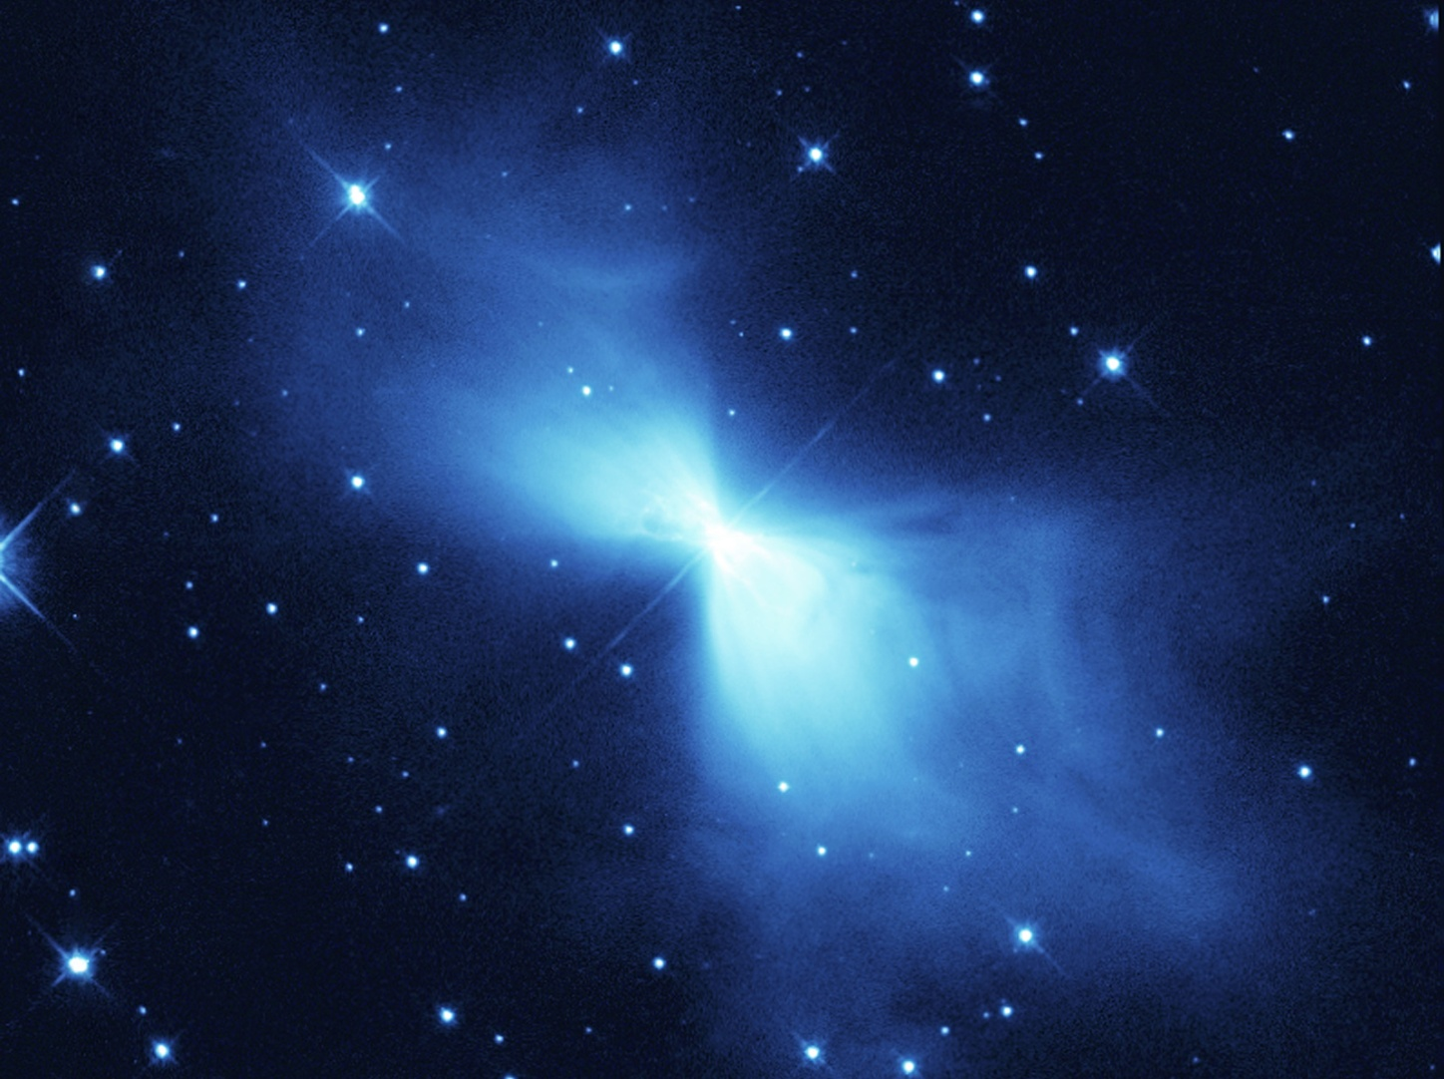
The Boomerang Nebula
This Hubble Space Telescope image shows a young planetary nebula known (rather curiously) as the Boomerang Nebula. It is in the constellation of Centaurus, 5000 light-years from Earth. Planetary nebulae form around a bright, central star when it expels gas in the last stages of its life.
The Boomerang Nebula is one of the Universe's peculiar places. In 1995 astronomers found that it is the coldest place in the Universe found so far. With a temperature of -272C, it is only 1 degree warmer than absolute zero (the lowest limit for all temperatures). Even the -270C background glow from the Big Bang is warmer than this nebula. It is the only object found so far that has a temperature lower than the background radiation.

Slide 8
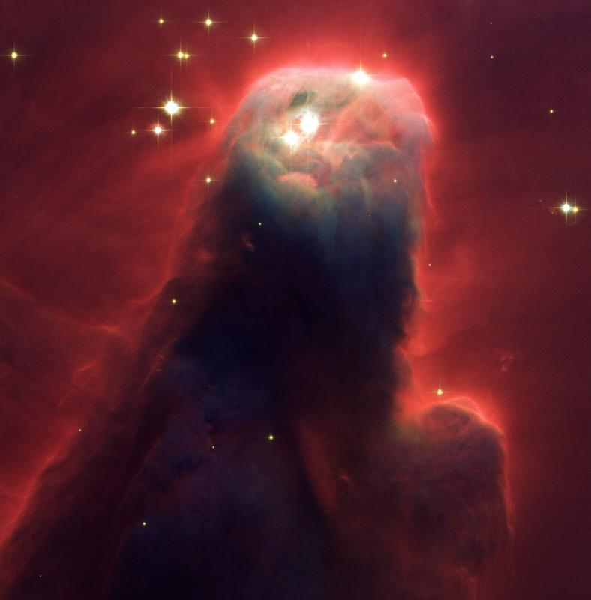
The Cone Nebula
This celestial object is a pillar of gas and dust. Called the Cone Nebula (in NGC 2264) - so named because in ground-based images it has a conical shape - this monstrous pillar resides in a turbulent star-forming region. The entire pillar is seven light-years long.
Radiation from hot, young stars (located beyond the top of the image) has slowly eroded the nebula over millions of years. Ultraviolet light heats the edges of the dark cloud, releasing gas into the relatively empty region of surrounding space. There, additional ultraviolet radiation causes the hydrogen gas to glow, which produces the red halo of light seen around the pillar.

Slide 9
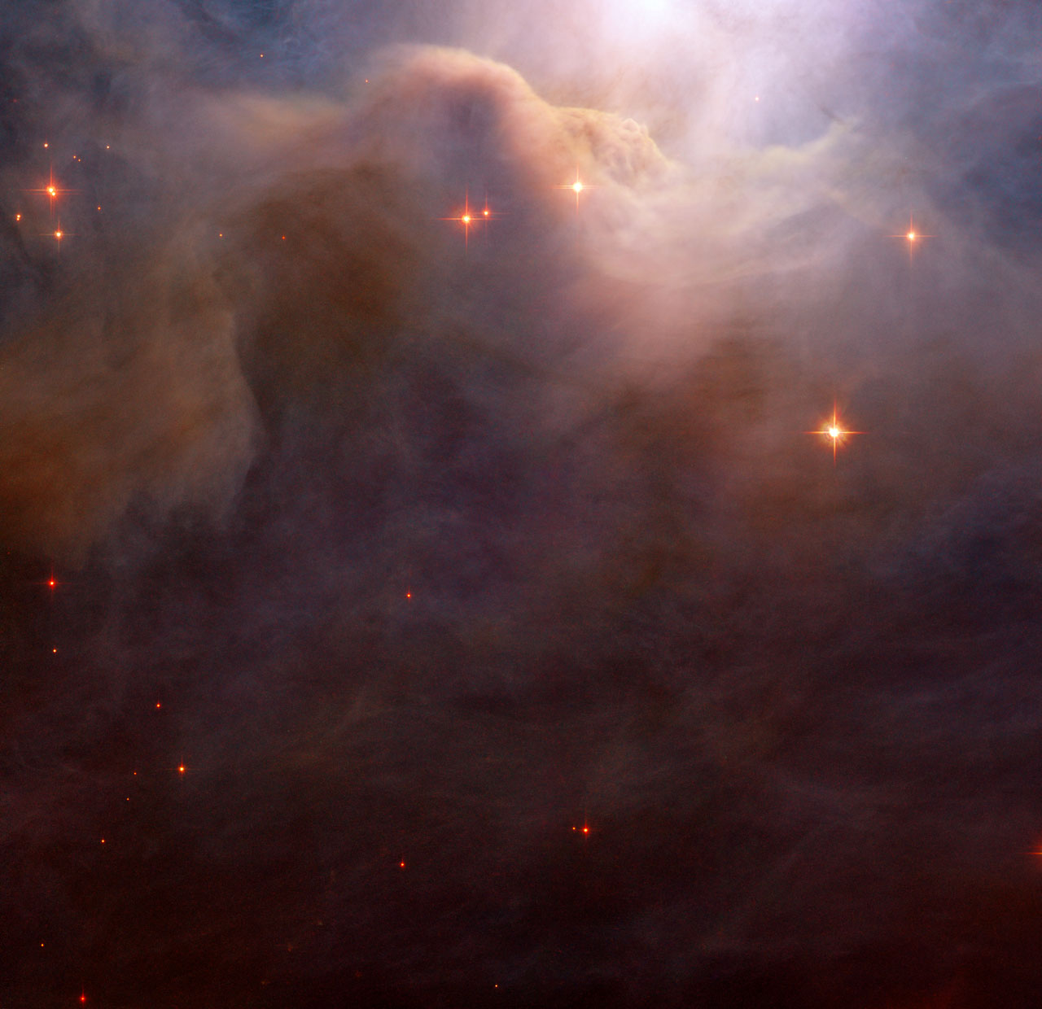
The Iris Nebula
This close-up of an area in the northwest region of the large Iris Nebula seems to be clogged with cosmic dust. With bright light from the nearby star HD 200775 illuminating it from above, the dust resembles thick mounds of billowing cotton. It is actually made up of tiny particles of solid matter, with sizes from ten to a hundred times smaller than those of the dust grains we find at home. Both background and foreground stars are dotted throughout the image.

Slide 10
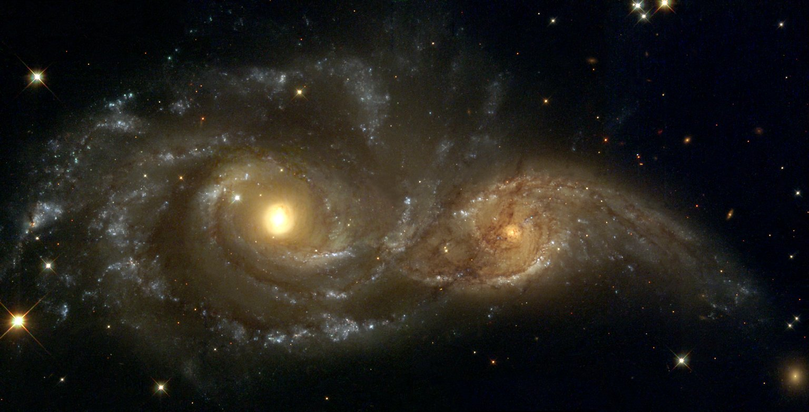
Two Spiral Galaxies
In the direction of the constellation Canis Major, two spiral galaxies pass by each other like majestic ships in the night. The near-collision has been caught in images taken by the Hubble Space Telescope. The larger and more massive galaxy is cataloged as NGC 2207 (on the left in the Hubble Heritage image), and the smaller one on the right is IC 2163. Strong tidal forces from NGC 2207 have distorted the shape of IC 2163, flinging out stars and gas into long streamers stretching out a hundred thousand light-years toward the right-hand edge of the image.

Slide 11
Info and pictures from:
http://www.spacetelescope.org/images/archive/top100/

