Slide 1
A+!!!!!
How To Pass Tests
By Idalia Medina, Community Advisor
Iowa State University

Slide 2
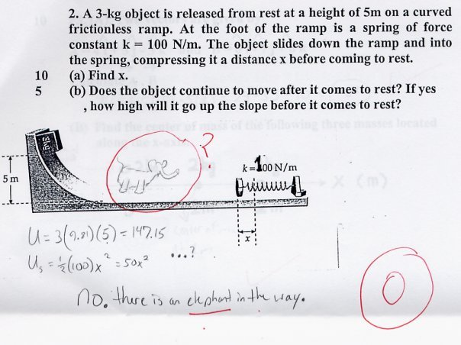
Figure out a way to incorporate wild life into all of your answers.
Seriously though, find other people to study with who happen to have elephant repellant that is made out of KNOWLEDGE.

Slide 3
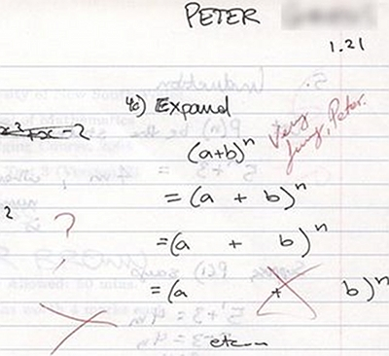
Make sure that you understand the directions. Sometimes taking things literally may not be the best way to get points.

Slide 4
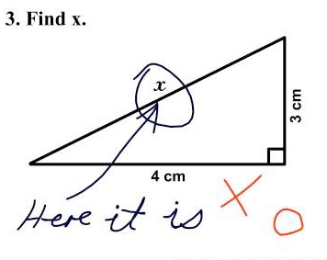
Do not forget that the simplest answers are sometimes the answer.
Seriously, if you are not understanding the material, it might be a good time to go see your professor if your first answer is anything like the one above. On the other hand, if this was a real answer, I would have dominated math.

Slide 5
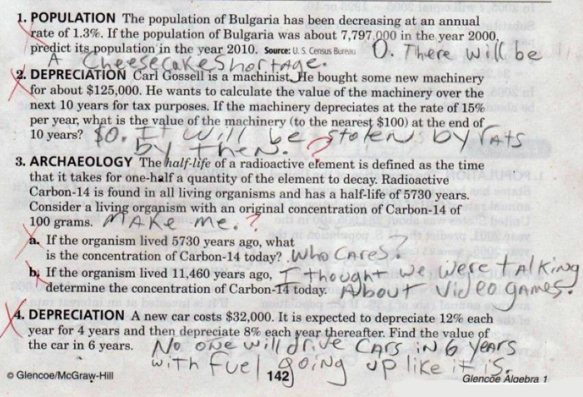
Feel open to sharing your true opinions with your professors. They love hearing what students think because they always like amusing reasons to use their red pen.

Slide 6
Make connections to real life experiences. The more probable, the more likely that you are right.
Seriously though, try to keep your answers on point. In math for example, check your units. In essays, check that you actually answered the question asked.

Slide 7
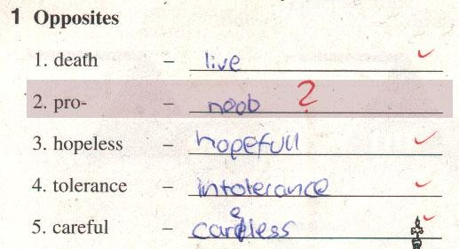
Video games have real-life applications to tests. By that logic, playing videos is really a studying experience.
Seriously though, incorporating slang into a word problem might not be the best idea. That would be the same as using txt talk in a ppr 4 Engl. Always check over everything you submit for errors. I can not even TELL you how many times I have caught errors that later resulted in a pretty AWESOME grade. Oh, and SPELL CHECK IS YOUR FRIEND!!!!!

Slide 8
Thinking out of the box is often a skill that is tested during exams. The only way to pass the test is to acknowledge the existence of said box and then CRITICAL STRIKE (with knowledge.) You will find magical beams of genius shooting out of it.

Slide 9
This was actually a question asked on a art final in order to weed out the spectacular from the average. Those that saw the REAL picture, went on to work for NASA.
P.S. – The answer is C.
P.P.S – If you do not know the answer, at least give it a shot. Teachers like giving out partial credit if they see that you made an effort instead of simply twiddling your thumbs.

