Slide 1
Dalmatian Door Tags and Bulletin Board Idea
Dan Auber
Resident Assistant SUNY Oneonta

Slide 2
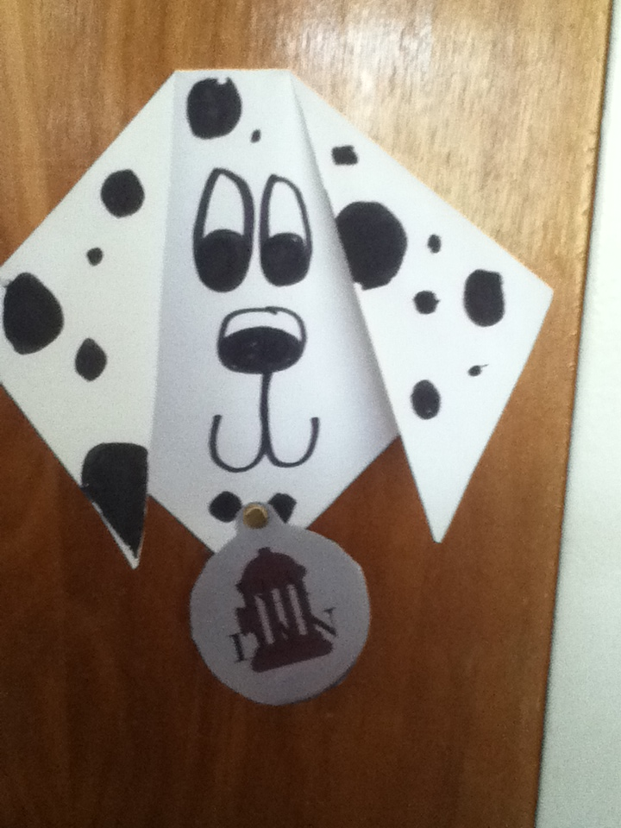

Slide 3
Note from Author
I found this fun easy paper craft online and thought it would be perfect for dog tags!

Slide 4
Supplies
All you need is:
Paper A black marker Scissors Paper fasteners

Slide 5
Step one
Start with a square piece of paper.
If you start with a rectangular piece of paper, fold the paper over to make a triangle and cut off the excess paper.

Slide 6
Step Two and Three
Fold over the corners to make the ears.
Decorate your Dalmatian with a face and spots!

Slide 7
Step Four
For the names, I found a picture of an actual dog tag, and just put a text box with their names in it over the image!
I cut them out and used a paper fastener to lock the tag in place.

Slide 8
Step five
Give each dog different spots, eye shapes, nose shapes, to create unique individualized tags with their own personalities!

Slide 9
Tie it together with a Bulletin Board
I complimented the tags with a "101 facts" bulletin board to keep with the Dalmatian theme

