Slide 1
Stop Smoking Bulletin Board and Program Idea
Scott Towers
Resident Assistant
Western Connecticut State University
Featured Institution

Slide 2
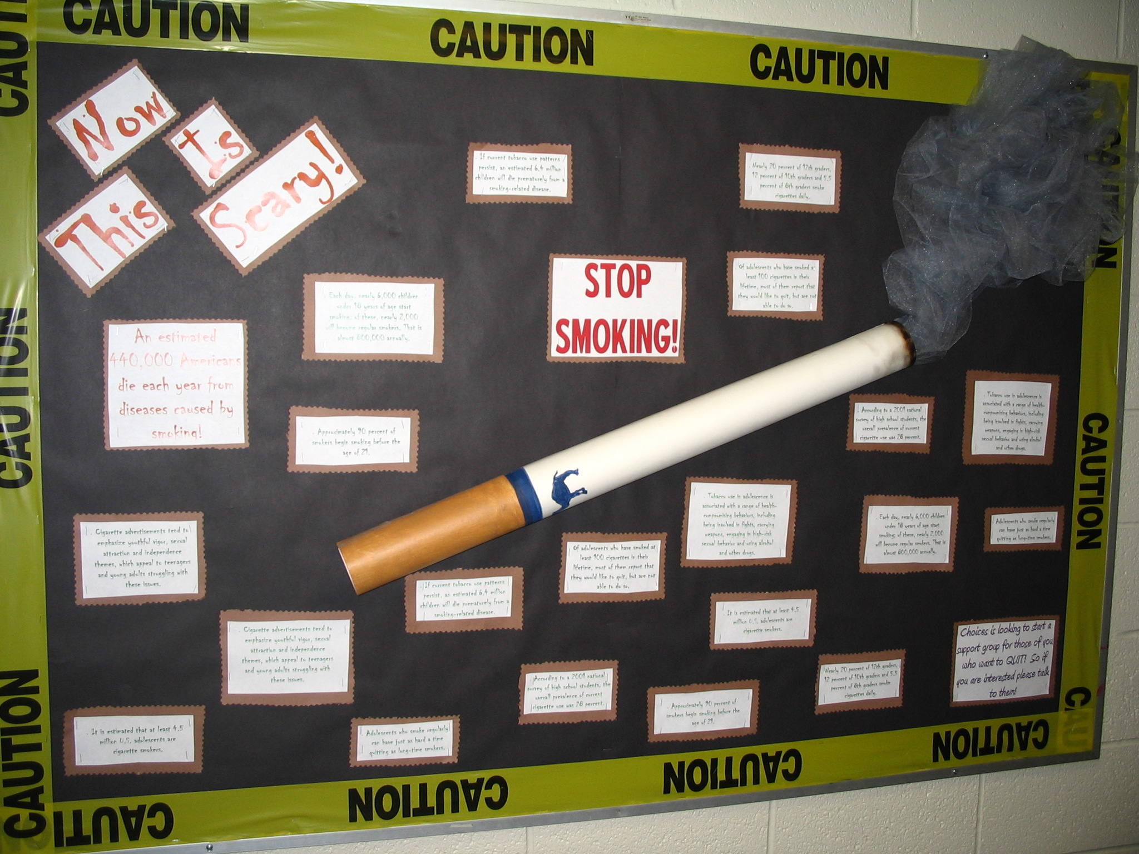

Slide 3
Note from Editor
This board could easily complement a program about making healthy choices with a focus on smoking cessation.
Introductions, Overview, and Goal of session
How many of you know someone who you care about who smokes?
How many of you know someone who has died from smoking related causes?
Facts (number who die each year related to smoking, number of children impacted, number impacted by second hand smoke)
How to quit/How to help a friend quit
Why is this important? How does smoking/second hand smoke impact your life?
What resources are there to help?
Panel of past smokers
Question and Answer
Closure and Evaluations

