Slide 1
Social Justice and Harry Potter Submitted by Kendall Varin, University of Idaho
Based on an article by krystie lee yandoli
And the Harry Potter Series (Warner Bros)

Slide 2
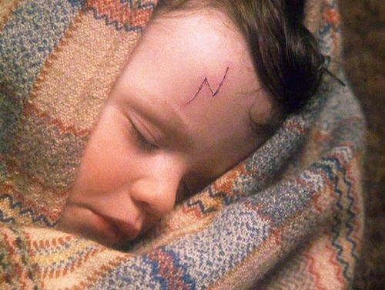
1. The Personal is Political
There’s no better way to understand how something affects society as a whole than to feel its implications on an individual level. Harry’s personal struggles are what make him such an effective agent for social change in the series. He lost his parents, godfather, and mentor all at the hands of Voldemort. Since he feels the impact of these issues so personally, it’s easier for him to see how they translate into larger political agendas.

Slide 3
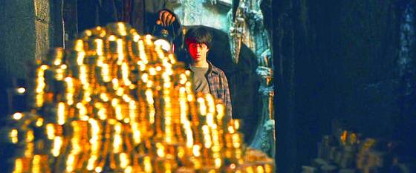
2. Check Your Privilege
Harry selflessly devoted his life to the cause of defeating Voldemort and the betterment of society, but he was well aware of all the tools and resources he had because he was “the boy who lived.” The surplus of gold his parents left in his Gringotts vault, special gifts like the Invisibility Cloak and Marauder’s Map, and his famous reputation all aided him in achieving his goals. These major advantages weren’t available to other characters, but Harry was always conscious of his privileges.

Slide 4
3. People in Power Aren’t Necessarily in the Right
Those who are in charge of major institutions don’t always have others’ best interests at heart. The Ministry of Magic had its own, secret agenda before it was even infiltrated by Death Eaters, and at one point Dolores Umbridge had run of Hogwarts and its students. It’s not always safe to assume that those in positions of power automatically do the right thing.

Slide 5
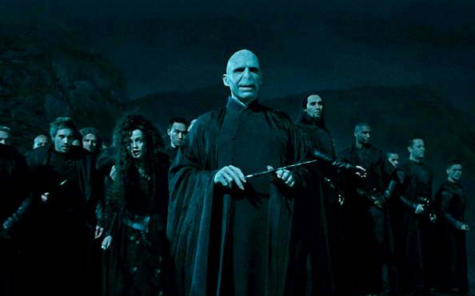
4. Avoid Blind Allegiance
Never follow leaders without question, no matter what they claim to stand for. The witches and wizards who don’t challenge Voldemort only make it easier for him to rise to more power. The Death Eaters obey every last order from Voldemort and remain eternally loyal despite his intentions. It isn’t until the very end of Deathly Hallows that the Malfoy family comes to their senses and walks away from the Battle of Hogwarts. Just because someone with conviction dictates what they want you to do, you shouldn’t follow them blindly.

Slide 6
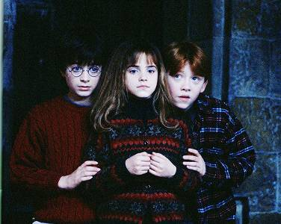
5. You Can’t Accomplish Everything Alone
While Harry was labeled the “chosen one” and often takes matters into his own hands, he wouldn’t have been able to ultimately defeat Voldemort without the help of so many others. He looked to figures like Dumbledore and Sirius for guidance, was shown unconditional love and support from the Weasleys and other Order of the Phoenix members, and Harry also heavily relied on Hermione and Ron to fill in the gaps (and even destroy a few Horcruxes). Social justice and fighting for what’s right doesn’t take just one person alone — it’s very much a group effort.

Slide 7
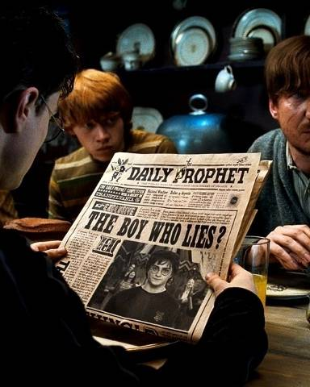
6. News Sources Aren’t Always Accurate
The Daily Prophet intentionally portrays Harry and Dumbledore negatively so the rest of the wizarding world doesn’t trust their word. As you continue on the path to fighting for what’s right, it’s important to be a critical consumer of mass media and not just believe everything you read in the news. All human beings have bias, and reporters aren’t any different; they can also be influenced by their own experiences and surroundings.

Slide 8
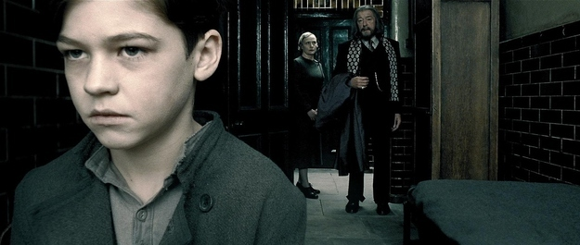
7. People Are Often Products of Their Environment
No one is born with a particular set of beliefs and opinions; as individuals, we all operate within the systems that shape us and affect our eventual outcomes. Tom Riddle was shaped by a number of experiences before he transformed himself into Lord Voldemort, from the orphanage that raised him to the problematic social norms that drove his Muggle father away from his witch mother, and even his experience in Slytherin house. He didn’t come up with his dark plans for the wizarding world all on his own.

Slide 9
8. Know Your Facts
In order to know where you’re going, you have to know where others have been. Hermione is especially good at reading into the past and understanding important histories so that the group is aware of others’ successes and failures. The more information you know, the better off you’ll be. It’s crucial to have full context.

Slide 10
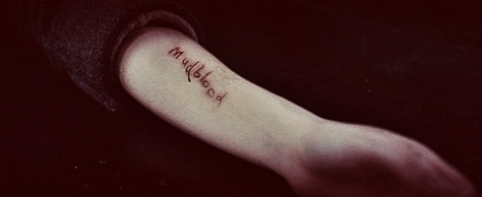
9. Injustices Operate Within Systems
Inequalities and evils aren’t just isolated incidents, nor do they come about by coincidence. Discrimination against house-elves, Muggle-borns, and half-bloods occurs because of the social structures that exist in the wizarding world. Other instances of injustice — like professor Umbridge’s “disciplining” of students and how Hagrid is treated as a giant — are evidence of greater systems perpetuating different kinds of oppression.

Slide 11
10. Love is the Most Important Tool You Have
One of the major themes in the entire series, love plays an essential role in overcoming the worst kinds of evil. It is a universal emotion that all human beings (and wizards) can relate to in one way or another, and is a major driving force behind social change. Love is strong enough to inspire Narcissa Malfoy to protect Harry against Voldemort because she wanted to know her son was safe and motivates characters like Fred Weasley to voluntarily sacrifice their lives for the greater good. Most importantly, it gives characters something worth fighting for. The world knows no greater force.

Slide 12
