Slide 1
November is Diabetes Awareness Month Submitted by Jewel M.D. Engram, Head RA McDaniel College

Slide 2
What is Diabetes? Types?
Diabetes is a condition wherein the body is unable to regulate itself, either by producing insufficient amounts of insulin or proving resistant to insulin.
Type 1 Diabetes - the pancreas produces little or no insulin, a hormone needed to allow sugar (glucose) to enter cells to produce energy.
Type 2 Diabetes - the body becomes resistant to insulin or doesn't make enough insulin

Slide 3
Symptoms of Diabetes
Increased thirst
Frequent urination
Bedwetting in children who previously didn't wet the bed during the night
Extreme hunger
Unintended weight loss
Irritability and other mood changes
Fatigue and weakness
Blurred vision
In females, a vaginal yeast infection

Slide 4
Risk Factors
Family History Anyone with a parent or sibling with type 1 diabetes has a slightly increased risk of developing the condition.
Genetics The presence of certain genes indicates an increased risk of developing type 1 diabetes.
Geography The incidence of type 1 diabetes tends to increase as you travel away from the equator. People living in Finland and Sardinia have the highest incidence of type 1 diabetes — about two to three times higher than rates in the United States and 400 times the incidence among people living in Venezuela.
Age Although type 1 diabetes can appear at any age, it appears at two noticeable peaks. The first peak occurs in children between 4 and 7 years old, and the second is in children between 10 and 14 years old.

Slide 6
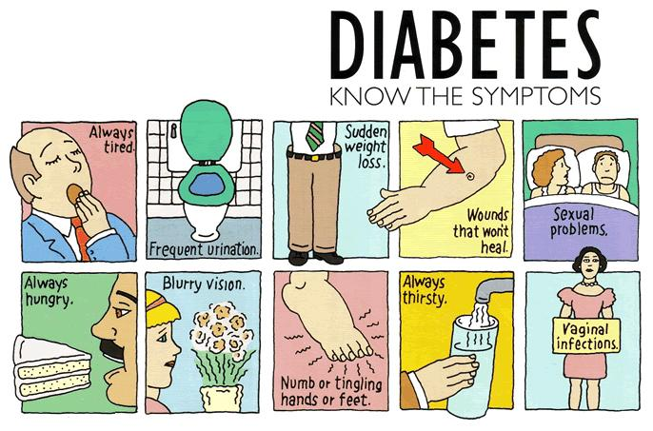

Slide 7
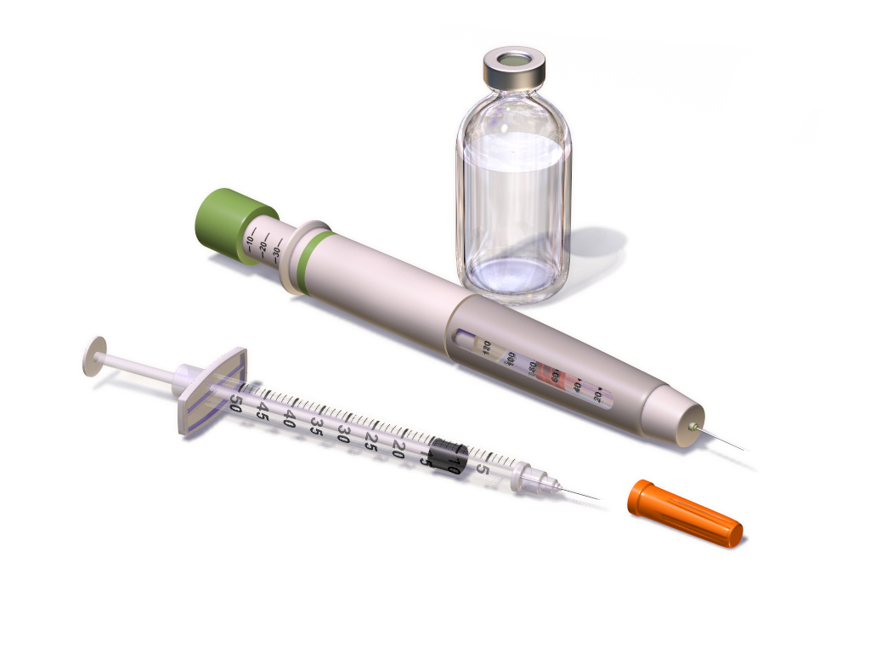
The Role of Insulin
Once a significant number of islet cells are destroyed, you'll produce little or no insulin. Insulin is a hormone that comes from the pancreas, a gland situated behind and below the stomach.
The pancreas secretes insulin into the bloodstream.
Insulin circulates, enabling sugar to enter your cells.
Insulin lowers the amount of sugar in your bloodstream.
As your blood sugar level drops, so does the secretion of insulin from your pancreas.

Slide 8
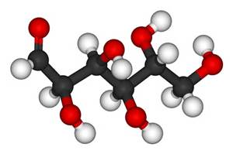
The Role of Glucose
Glucose — a sugar — is a main source of energy for the cells that make up muscles and other tissues.
Glucose comes from two major sources: food and your liver.
Sugar is absorbed into the bloodstream, where it enters cells with the help of insulin.
Your liver stores glucose as glycogen.
When your glucose levels are low, such as when you haven't eaten in a while, the liver converts stored glycogen into glucose to keep your glucose level within a normal range.
In type 1 diabetes, there's no insulin to let glucose into the cells, so sugar builds up in your bloodstream, where it can cause life-threatening complications.
The cause of type 1 diabetes is different from the cause of the more familiar type 2 diabetes. In type 2 diabetes, the islet cells are still functioning, but the body becomes resistant to insulin or the pancreas doesn't produce enough insulin or both.

Slide 9
7 Curious Facts About Diabetes
Male cats and female dogs are more likely to develop the condition than their counterparts.
Diabetes in animals has many of the same causes as it does in humans— genetics, diet, lack of exercise.
According to the American Diabetes Association, 28.5 percent of diabetics age 40 and over suffer from some form of retinopathy (Blindness).
The first person to be administered the insulin—which they derived from an ox—was a 14-year-old named Leonard Thompson, who was dying in Toronto General Hospital. He received his first shot on January 11, 1922.
Diabetes has plagued humankind for thousands of years, and was described in ancient Egyptian manuscripts dating back to 1550 B.C.
Those with severe diabetes must frequently check their blood sugar levels. Should they become too high (hyperglycemia) or fall too low (hypoglycemia), you run the risk of falling into a diabetic coma
In the United States alone, approximately 65,700 lower-limb amputations were performed in 2006 as a result of diabetes.

Slide 10
DIABETES DOES NOT DISCRIMINATE!

Slide 11
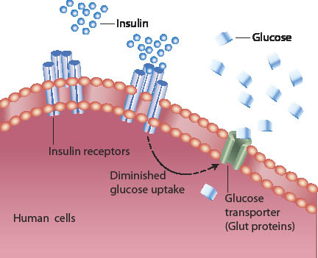

Slide 12
